Slide 1

My Materials
ETAMU BOOKSTORE
Instructor & Concierge Experience
09/2026

Slide 2
Contents
Accessing My Materials …………………………………………………………3
Adopt vs. Shelf ……………………………………………………………………..…4
View Your Courses in Adopt ………………………………………………….5
Readopting Materials …………………………………………………………..…6
Submitting an Adoption ……………………………………………..………….7
OER & No Materials Adoptions ……………………………………………..8
Adding Notes for Your Campus Store …………………………….…...8
Adding OER Content for Students …………………………………….....9
Requesting Missing/New Materials ………………………….………….9
Editing a Submitted Adoption ………………………………………………10
Message Center ……………….……………………………………………….....11
Support Contacts …………………………………………………………………..11

Slide 3

Accessing My Materials
Instructors
Signing into My Materials from TCU Online allows editing of all courses assigned to the instructor.
  Sign into ETAMU Online - https://easttexasam.follettdiscover.com
  Navigate to a current course
  Click on the “My Materials” link in the menu bar
  Note: If an instructor was a student in the past, two ‘login’ options (instructor and student) will appear. Click on the “instructor” option to be taken to the instructor experience.
Administrative Staff & Academic Leadership – Concierge Login
Signing into My Materials from the Concierge login allows editing of all courses within your assigned department(s).
Visit https://easttexasam.follettdiscover.com to sign into My Materials.
Utilize the password reset option as needed for existing accounts. To setup a new account or to edit your access to specific departments, please send a request to the campus store at 2460txt@follett.com.

Slide 4
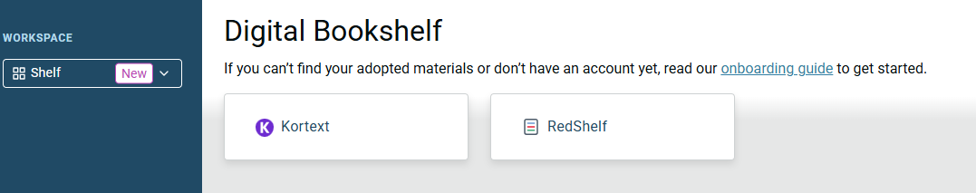
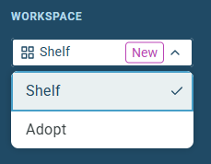
Adopt vs. Shelf
My Materials features two workspaces for instructors which are toggled from the upper left corner of the screen.
  Shelf: Direct access to your eBook shelves containing previously-provisioned eBooks and current desk copies.
  Adopt: Manage the materials listed as required and recommended for students enrolled in your courses. You can also list OER, add custom materials, and designate your courses as OER/No Titles Required.
Note: Concierge user login only provides access to the Adopt workspace.
Navigate to “Adopt” to manage materials for current and upcoming terms.

Slide 5
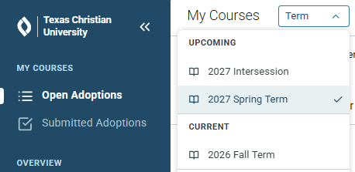
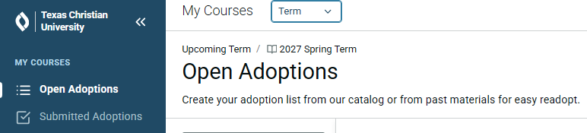
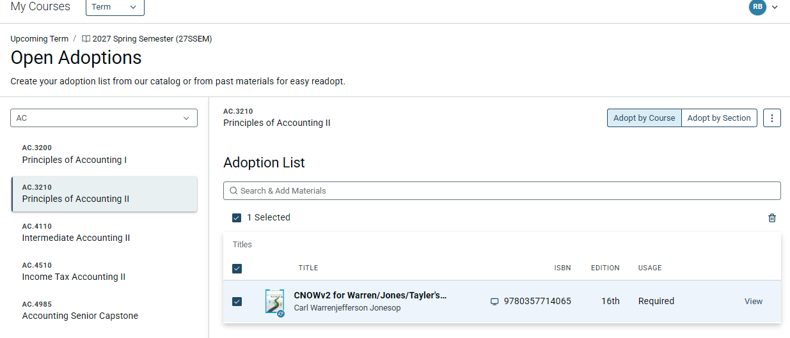
View Your Courses in Adopt
Select the Term for which you
want to manage adoptions:
Your assigned courses or departments for the selected term will display on the dashboard.
  “Open Adoptions” is the default view. This is a list of all unconfirmed adoptions for the selected term. Re-adopt or submit adoptions in this menu.
  “Submitted Adoptions” will display all confirmed adoptions for the selected term. Edit existing adoptions in this menu.
Select the course for which you want to manage adoptions. You can make submissions at the course-level or section-level by using the toggle in the upper right of the course view.

Slide 6
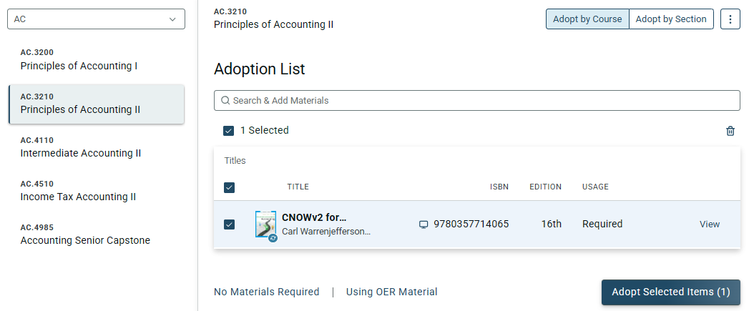
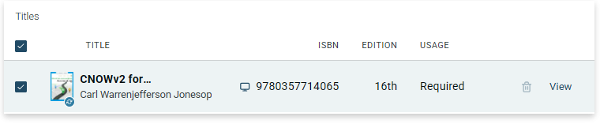
Readopting Materials
Open Adoptions with available readoptions will be listed and selected by default.
To readopt these materials, select “Adopt Selected Items.” This will confirm the materials on the course/section.
If you will no longer require the previous material, hover over the title and select the Delete icon. Proceed with updating the course with the instructions on the following pages.

Slide 7
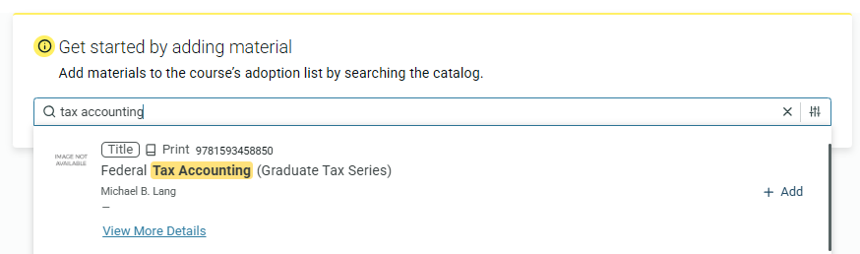
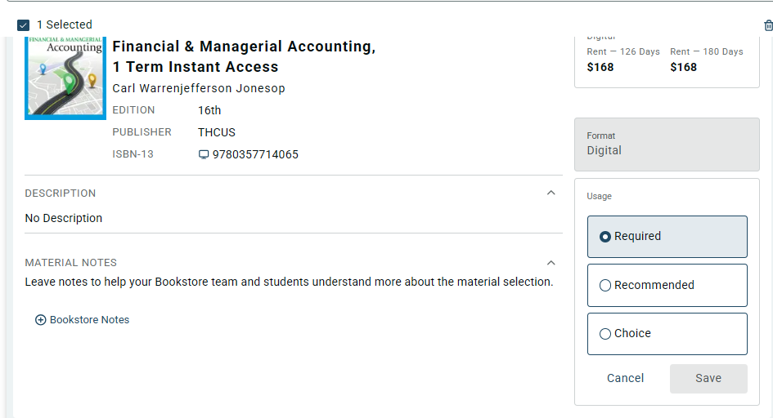
Submitting an Adoption
For your Open Adoptions, search for your selected material by author/title or, for exact results, search by ISBN (no spaces or dashes). View additional details or select “Add” to add the material to your course.
After adding a material, select “View” to display details of the adoption.
Edit the Usage status for material. Required indicates the material is required for the course. Recommended should be selected for optional materials. Choice should be selected only if students will choose between 2 or more different titles.
Note: Choice is not necessary for choosing between print and eBook of the same title. Select required or recommended for different formats of the same title.

Slide 8
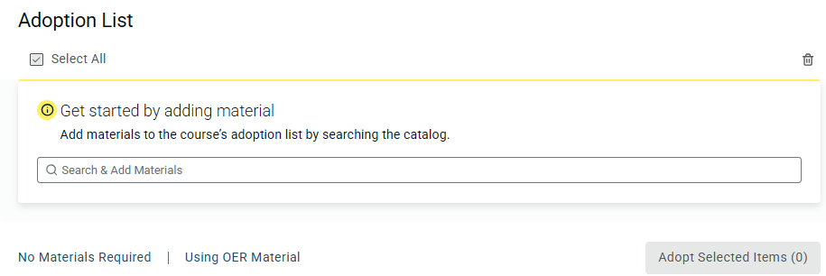
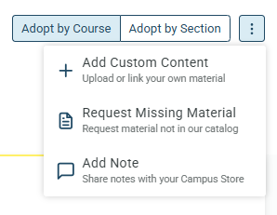
Open Educational Resources (OER)
& No Materials Adoptions
If only OER materials, or no materials, will be utilized in the course, select the appropriate hyperlink at the bottom of the course/section.
Adding Notes for Your
Campus Store Team
Step 2
To provide clarification on selected materials to the Campus Store Team, you can Add a Note to the course. This note is only visible to store staff.
Examples of notes to the store include:
Access to online platform required
No technology/eBook classroom
Clarification on choice titles
Details for adding new titles
Enrollment estimates

Slide 9
Adding Open Educational Resources (OER) Content for Students
You can add a link or file for students that will appear in the student experience of My Materials for your course.
Select the “Add Custom Content” option for your course or section to upload your custom content.
Follow the prompts to add the material to your course.
Requesting Missing/New Materials
Step 2
For titles not found when searching for a new material, you can request to add it to the bookstore catalog.
Select the “Request Missing Material” option for your course or section.
Follow the prompts to add details of the new material and send the request to the campus store.

Slide 10
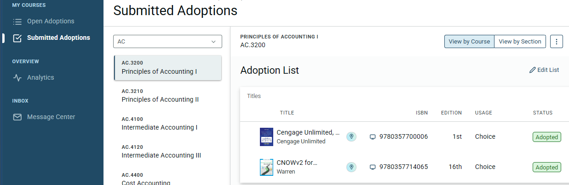
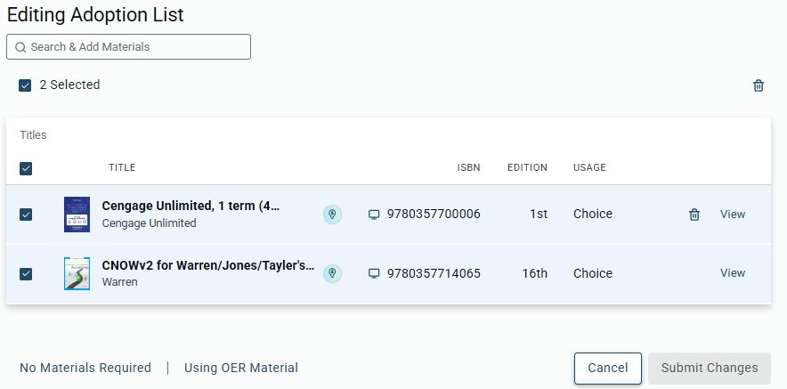
Editing a Submitted Adoption
If changes are needed to an existing adoption, navigate to your Submitted Adoptions courses.
Select the course/section you wish to edit and the “Edit List” hyperlink.
From here, you can hover over a title to Delete it, View details to change the usage status, or update the course/section to Open Educational Resources (OER) / No Materials Requested.

Slide 11
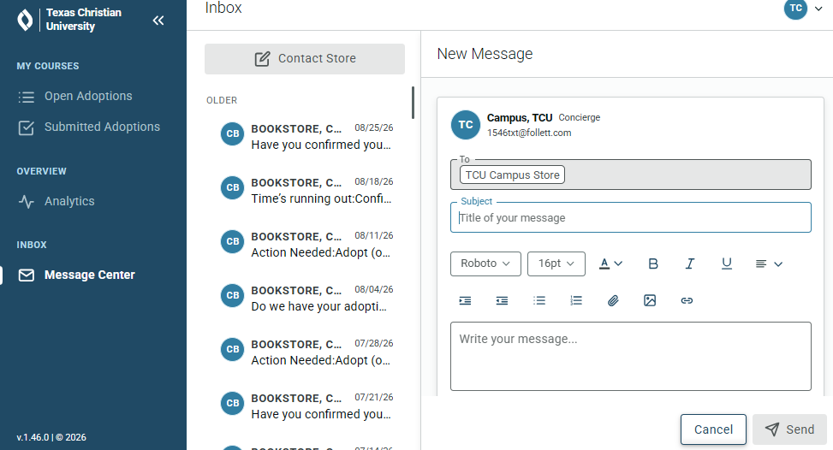
Message Center
My Materials for Faculty and Staff features a Message Center for communicating with the campus store. Responses will be visible in the Message Center and in your email.
ETAMU Campus Store | Course Materials
2460txt@follett.com
Support

