Slide 1
Five ways to lower text costs
How to get the best textbook for your course at the best price for your students

Slide 2
REC
RQ
OF
#1.
Use the correct recommendation setting when turning in text decision

Slide 3
Recommendation options for turning in text decision
Recommended
Rec
Required
RQ
Optional Format
OF

Slide 4
The “Recommended” Status for a textbook should be used for textbooks that have no assignments.
Recommended textbooks:
  Books students will use in the field of their choice
  Books to help students with understanding concepts
  Study guides tied to the required text (that do not have assignments)

Slide 5
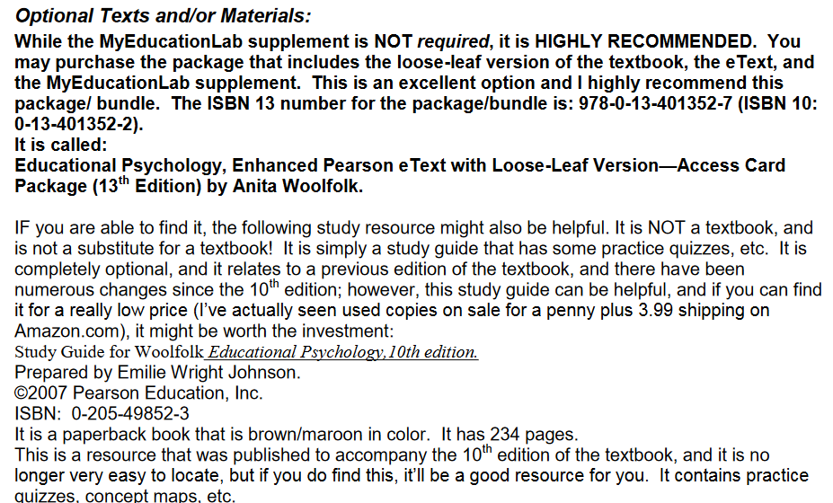
The “Recommended” Status for a textbook should be used for textbooks that have no assignments.

Slide 6
The “Required” Status for a textbook should be used for textbooks that have assignments or contain material students will be tested on.
*Important Required textbook note*
  If an instructor assigns problems found only in a book, that book edition must be submitted as “required”. Also, be sure to note it on your turn-in to the bookstore!
    Often when the bookstore submits needed ISBNs to a publisher, the publisher will substitute to the latest edition. The note helps the bookstore ensure the correct product gets to the student in the least amount of time.

Slide 7

The “Required” Status for a textbook should be used for textbooks that have assignments or contains material students will be tested on.

Slide 8
The “Optional Format” Status for a textbook should be used for textbooks that have assignments, and can be used in place of the required text if needed.
Optional Format textbooks:
  E-books
  Older editions
  Loose-leaf, paperback or hardback versions of the book assigned
  With or with out access code packages

Slide 9
The “Optional Format” Status for a textbook should be used for textbooks that have assignments, and can be used in place of the required text if needed.

Slide 10
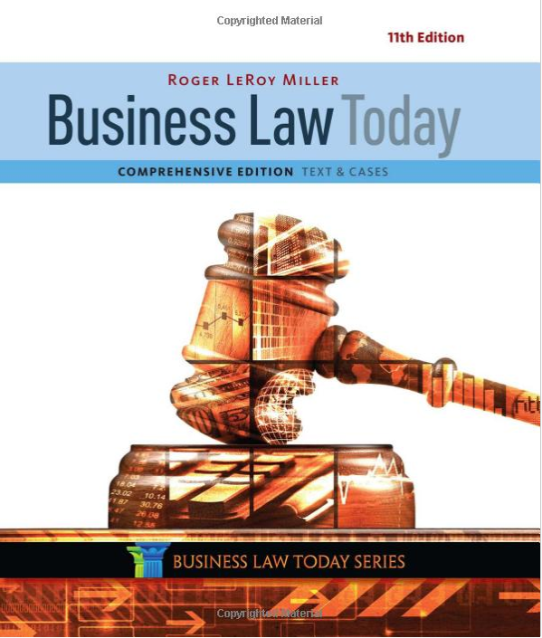

Change up the format
#2.

Slide 11
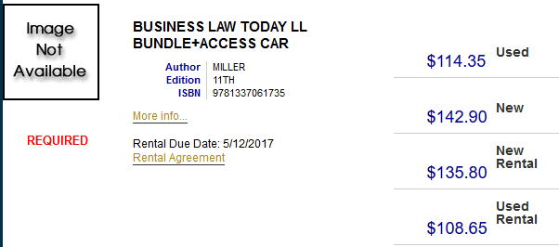
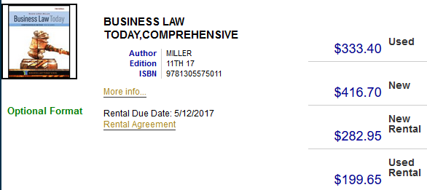

Simply switching from a Hardbound to a Paperback or Loose-leaf version can make a big difference on the buyer’s wallet!

Slide 12

Choose age appropriate material
#3.
Take the following factors into consideration when turning in texts for a class…

Slide 13
Textbook Age Factors
Availability vs. Class Size
Rental Pricing
Book Condition

Slide 14
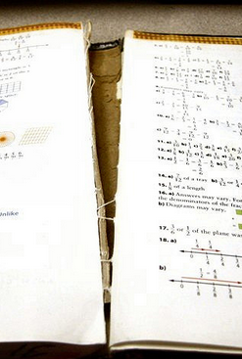
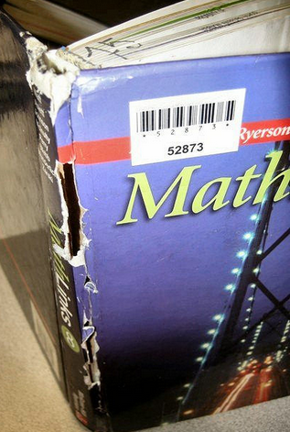
Book Condition
Books contain the knowledge to beat the odds and succeed in life.
However, books are often not treated as sacred texts to be cherished by college students.
Rule of thumb: If it’s older than 5 years, it’s not in the condition anyone wants to sell.

Slide 15



Rental Pricing
Bookstore sends list of texts to wholesalers to bid on
Wholesalers evaluate the next semester’s supply & demand, and offer prices accordingly
Bookstore subtracts wholesaler bids from retail price to get rental pricing

Slide 16
Rental Pricing- Age Matters
Wholesalers look at the following to determine rental prices
Edition of book
  How many editions are there?
  The most current gets the highest quote
  No rental bids are offered on any editions older than the last 2 editions
Current Demand for the book
  No rental bids are offered on custom editions only used at one (or few) universities
  Higher rental bids are given to books used by multiple major universities in the U.S.

Slide 17

Availability vs Class Size
“Older edition” or “Out of Print” books mean the book is no longer being printed and must be ordered from alternate sources, usually at cheaper prices.
However, don’t forget to take course class sizes in consideration before making these textbooks “Required”.

Slide 18

Class of 96 students using this Out of Print book
Only 12 available on the marketplace
Starting price is $203.83

Slide 19
#4.
Turn-in text decisions on time to the Bookstore

Slide 20
On-Time Textbook Adoptions Advantages
Increases the amount of money students receive in buyback at the end of the term, if the same books are used again
Return unsold and unused books to the publisher
  If a book will be reused we can reduce the cost associated with returning and reordering
  More $$$ for campus
Facilitates buyback and used book ordering
Decreases the chance of ordering problems
Lower textbook prices for students

Slide 21

Using the book multiple semesters for a course?
Knock out four semesters worth of deadlines in one swoop! Have your Dean sign the bookstore multi-semester contract to lower the rental text prices in the bookstore for students!
  Lower rental prices only apply to books without digital components
  Contracts available to sign April 15th

Slide 22
Textbook Ordering Cycle
Course materials are selected
Adoption information is submitted to the bookstore
Bookstore researches availability & sends list of books out for rental bids
Bookstore determines quantities & acquires inventory
Inventory arrives at bookstore
Unsold books are returned to vendors after peak selling period

Slide 23
Timelines for Text Turn-Ins
For Summer and Fall semesters, we begin asking for course requests in March with submission deadline of April 15th
For Spring and any compressed Winter semesters, we ask for course requests turned in by October 15th
Why We Request Information Ahead of Time
It gives us time to review all the orders
It gives us time to search for used books
It gives us time to communicate with you
It gives us time to seek lower priced alternatives

Slide 24
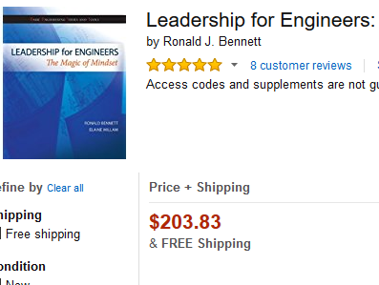
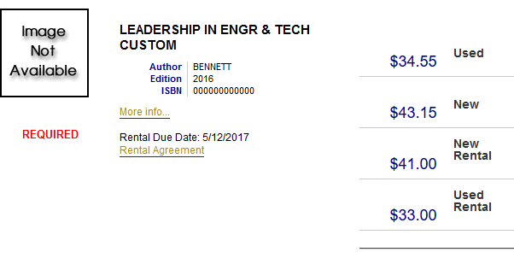
Remember that Out of Print Book for class of 96?
On-time text adoption allowed us to turn this
Into this

Slide 25
Textbook Acquiring Timeline for Fall
Time | Action Taken by Bookstore
April | Make buyback quantities and order decisions based on class size and sale history
April/May | Begin buyback for textbooks required in upcoming semesters Submit book list to wholesalers for rental bids Store competes against other universities for highest bids & quantity allowed
Late May/June | Post books bought back to inventory and begin sourcing for used books from wholesalers
Second Week of June | Submit any custom or print on demand orders to publisher
First Week of July | Order new editions, access codes and/or bundles from publisher
Second Week of July | Order new texts from publishers (This is the remaining need by the bookstore that was not fulfilled by wholesalers)
Second Week of August | All books received, stocked and on shelves for purchase

Slide 26
Arrival of Books
Timeline:
All publisher book orders have a 24-48 hour process time, with an additional 5-7 business day transit to the bookstore
All wholesale orders have a 24 hour process time, with an additional 3-6 business day transit to the bookstore
All online orders have a 24-48 hour process time, with an additional transit time.
  Most orders take 15 full business days before arriving in store.
  Often orders are cancelled if vendor finds out it is a bookstore ordering in multiple quantities.

Slide 27

On-Time Textbook Adoptions Advantages:
Provides students a greater selection
Lower prices through better rental bids,
More used copies
Price matching stocked titles during the 1st week of classes!

Slide 28
#5.
Make sure to use
the required text
in the course

Slide 29
HEAO Regulations
Requires that a college who receives federal financial assistance to provide students with the accurate course material for each course listed on the course schedule for preregistrations and registration purposes. The following information must be included:
  ISBN
  Retail price
  link to the school’s bookstore’s website located on the course schedule via internet or printed
Encourages stakeholders to work together to reduce course material costs
Requires institutions to provide their campus stores with enrollment information and adoption information
Expands campus-based financial aid programs’ formula for books and supplies from $450 to $600 in July 2010

Slide 30

Involve
Involve full-time instructors and adjunct faculty when making textbook recommendations for courses
Need
Supplemental materials should be selected based on demonstrated and justified need; students must be held accountable for required supplemental materials
Benefit
Package and bundle only when it benefits the students
Packaged, bundled, custom publications and print-on-demand books can take up to eight weeks longer than a traditional book to arrive

Slide 31

Questions?
Contact Us:
Ruth Campos- General Manager
P: 903-886-5830| E:bookstore@tamuc.edu
Audrey Hastings- Textbook Manager
P:903-886-3148 | E:textbooks@tamuc.edu

