Slide 1

Census Date Faculty Rosters

Slide 2
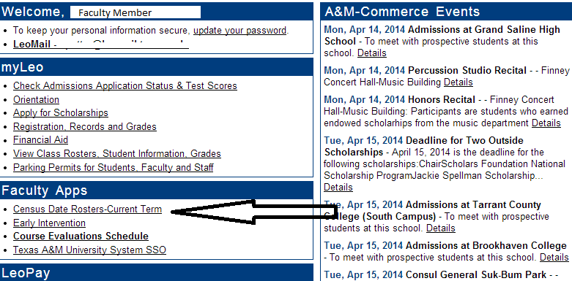
Select:
“Census Date Rosters-Current Term”

Slide 3
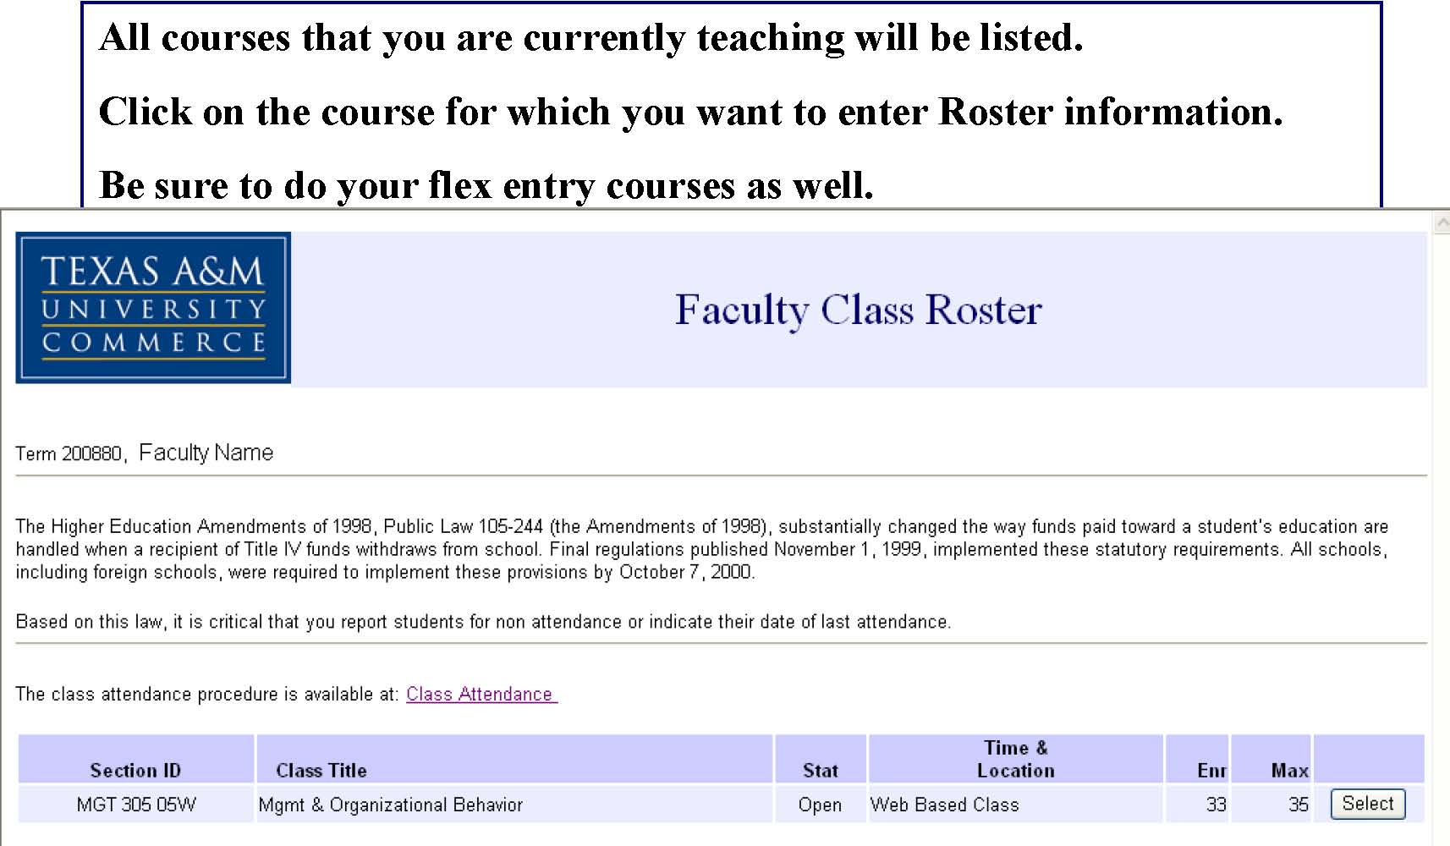
Click “Select” to the right of the screen

Slide 4
Roster
On the roster itself, enter the attendance information for your students.
  If the student has never attended, report as such by selecting “Never”.
  If the student did attend, but has since stopped, note that the student attended AND note the date last attended.
  If the student is regularly attending, mark “yes” under the “has attended” column.

Slide 5
Then check the box and acknowledge that the information is “true and correct.”

Slide 6
Office of the Registrar
Molly Baur, Associate Registrar
Molly.Baur@tamuc.edu
903-886-5064
Andrea Potter
Enrollment Auditor
Andrea.Potter@tamuc.edu
903-886-5070

