Slide 1

On-Line MyLeo
Drop Course Procedures
2008

Slide 2
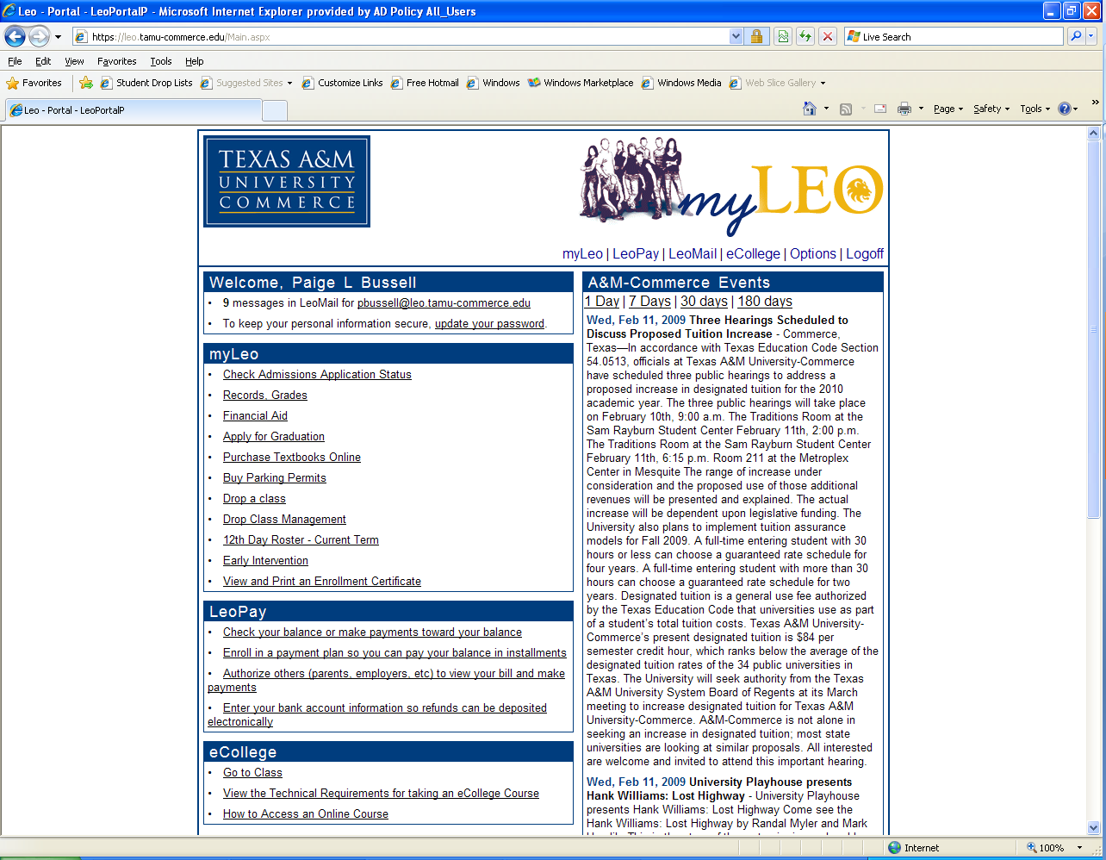
Faculty will receive an email that student has submitted a drop request
Faculty will need to login through MyLeo and click on “Drop Class Management”

Slide 3
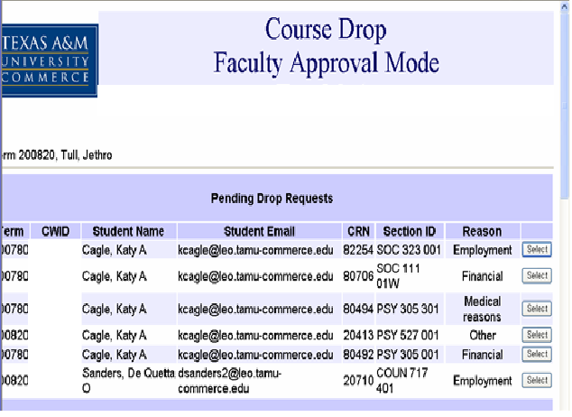
A list of pending drops for students in courses you teach will appear.
Click “Select” for the student whose Drop you wish to approve or deny.

Slide 4
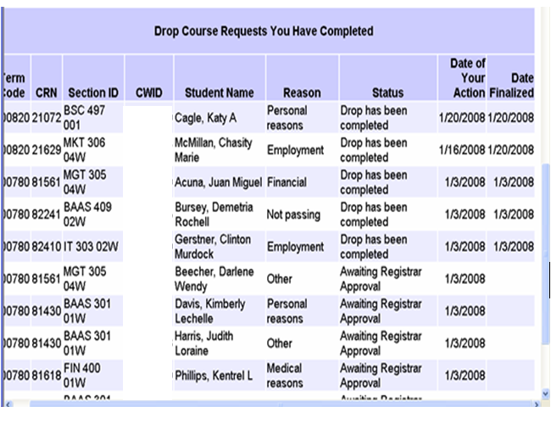
A list of completed Drops will appear at the bottom of the page

Slide 5
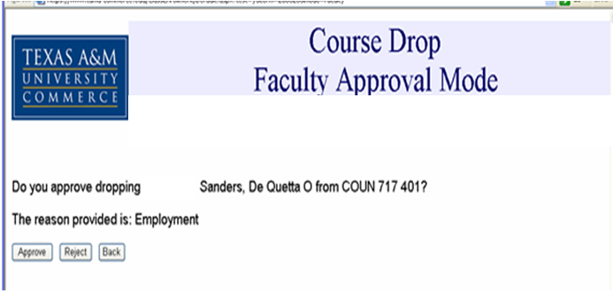
If you wish to approve the Drop request, click on the “Approve” button. The request will be submitted to the Registrar’s Office for processing.
If you wish to deny the Drop request, click on the “Reject” button.
  A comment screen will appear for you to enter comments for the student.
  An email will be sent to the student with your denial and comments.

