Slide 1

12th Class Day Faculty Rosters
Online reporting
Office of the Registrar
Tamara Lane, Associate Registrar
Tamara_Lane@tamu-commerce.edu
903-886-5069
Stacy Gould
Enrollment Auditor
Stacy_Gould@tamu-commerce.edu
903-886-5070
2008

Slide 2
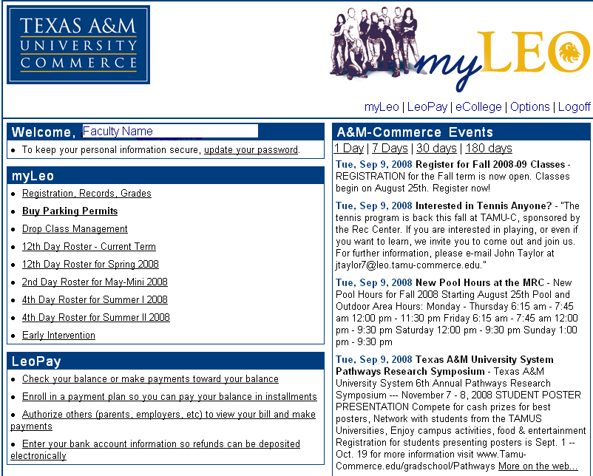
The Faculty’s Role
From the main screen of MyLeo, click on 12th Day Roster – Current Term

Slide 3
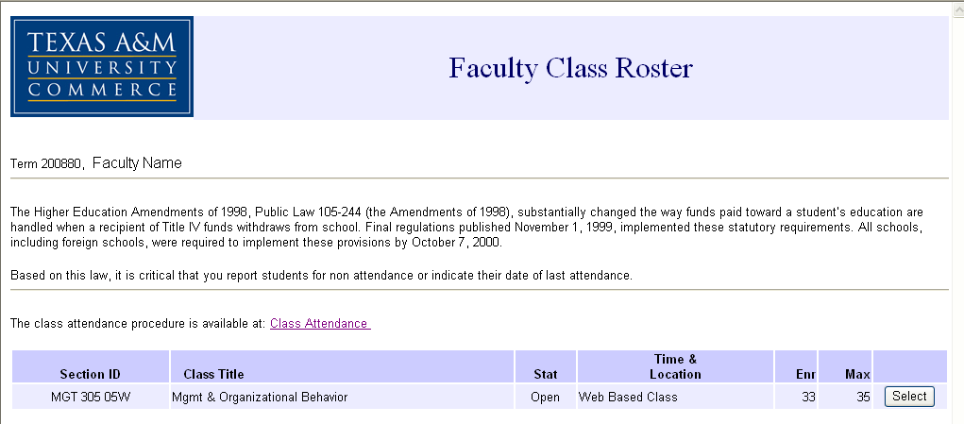
The Faculty Roster
All courses that you are currently teaching will be listed.
Click on the course for which you want to enter Roster information.
Be sure to do your flex entry courses as well.

Slide 4
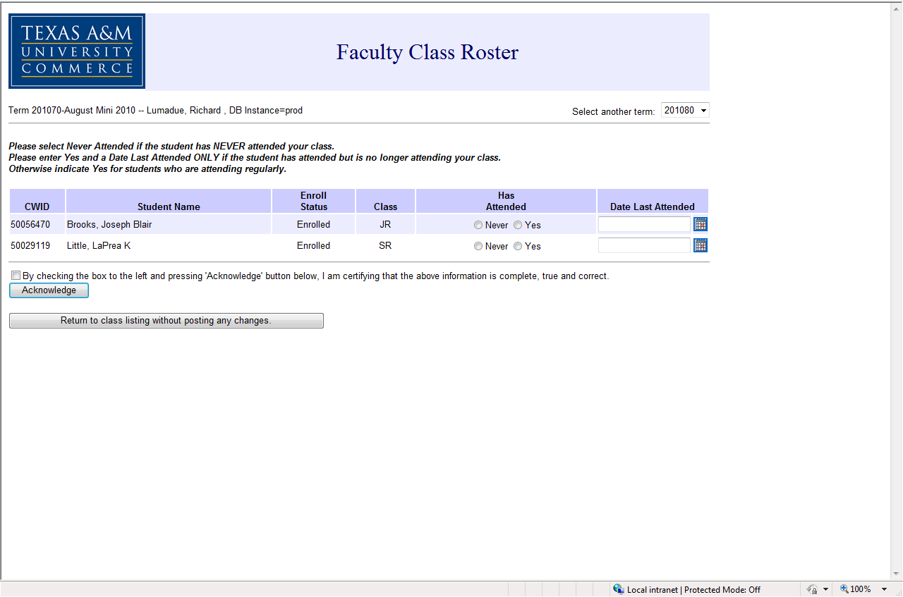
The Faculty Roster
999999999
Student name
999999999
Student name

Slide 5
The Faculty Roster
After updating the roster, scroll down to the bottom of the roster, read the validation statement, check the box and then click on the “Acknowledge” button.

