Slide 1
How to Re-Register Your Organization

Slide 2
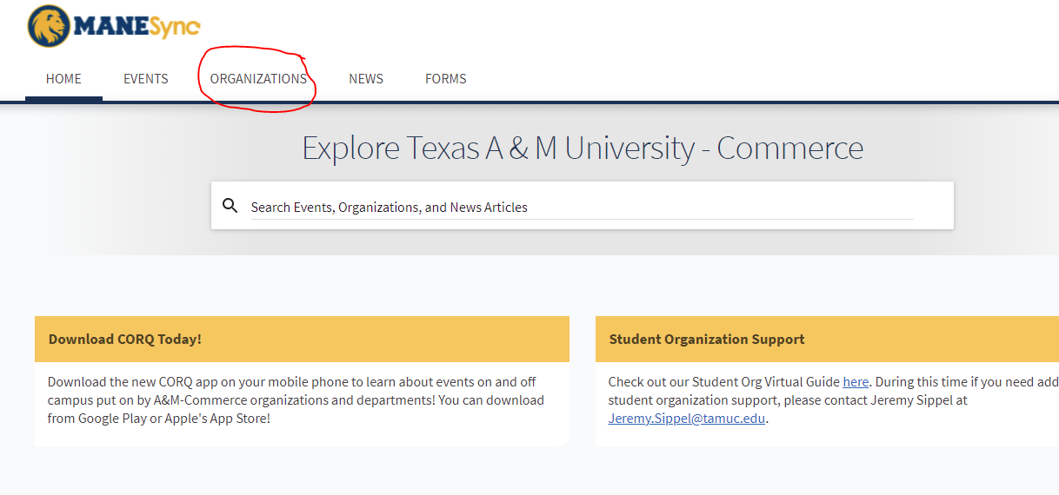
Step 1. Log in to ManeSync and click on Organizations at the top of the homepage

Slide 3
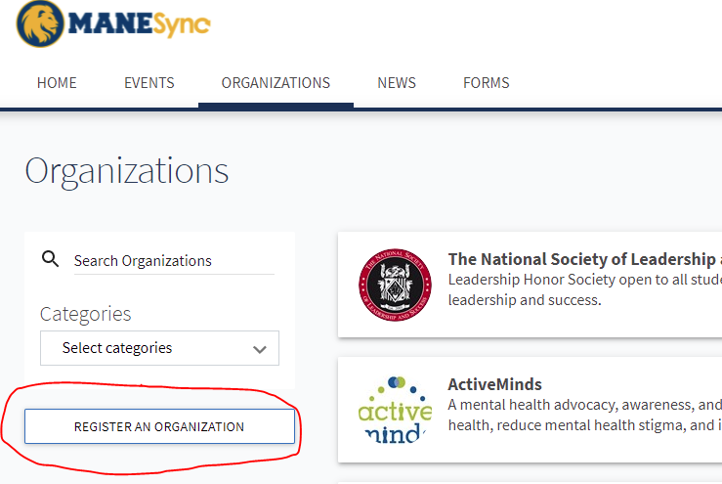
Step 2. On the Org Directory, click the button on the left side that says “Register an Organization”

Slide 4
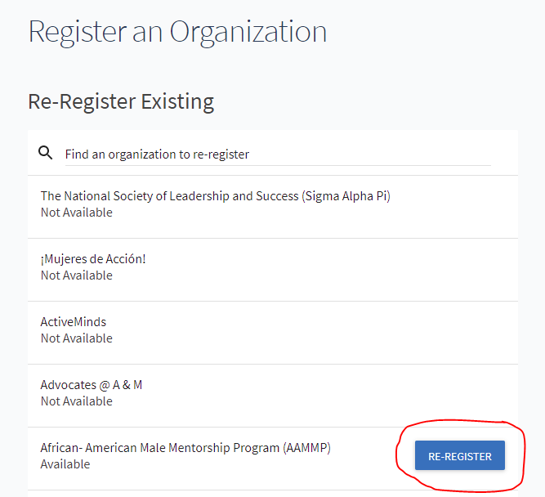
Step 3. On the next page, search for your organization (you can type the name of your organization in the search box). When you find your organization, click the blue “re-register” button.

Slide 5
Step 4. You will be taken to the registration pages.
The first page is the About page. It will be pre-populated with information. Please complete ALL pieces of information and update any needed changes.
*new for 2021...Additional Information will be required with Org President/E-mail, Org VP/E-mail, Org Treasurer/E-mail, Advisor/E-mail, and Organization Meeting Time/Date/Location

Slide 6
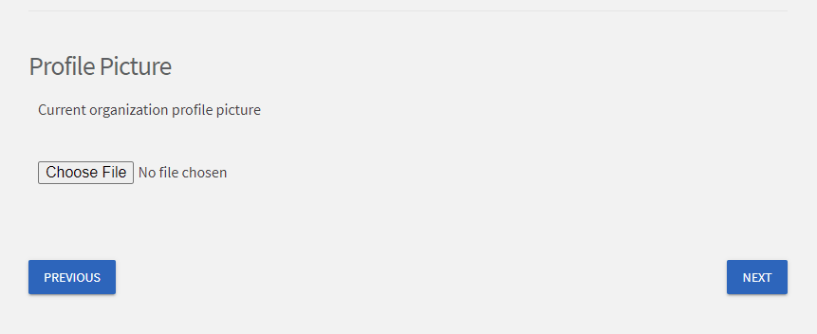
Step 5. You can add a profile picture. If you are going to use any likeness of TAMUC (logos, name, etc.), it must be approved by TAMUC Marketing and Communications.

Slide 7
Step 6. Select the CATEGORY your organization fits. DO NOT select random categories because this messes with the ability for a student to be able to search for organizations that match their interest. To select your category, just click on the category name.

Slide 8
Step 7. Update your Roster. You will need to have all officer positions filled (President, Vice President, and Treasurer).
Delete any students who are no longer members or have graduated.
If you do not update this section, your registration will be denied. Make sure membership matches with Executive Officers put in previous sections.
If you cannot see members, please e-mail Jeremy.Sippel@tamuc.edu to get admin access to view members.
You can add members by bulk just using e-mails, or input each member individually by typing e-mails, name, and position.
When adding members, use LEOMAIL e-mail addresses. ManeSync does not recognize other random e-mail addresses.

Slide 9
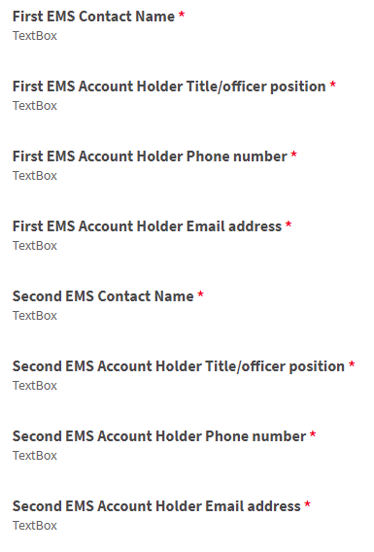
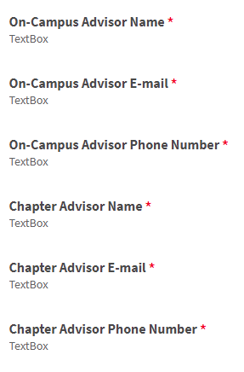
Step 8. For Fraternities/Sororities, add advisor information, for other organizations add EMS contact information.
Fraternities and Sororities
Other groups

Slide 10
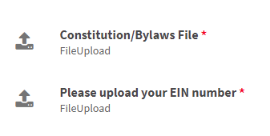
Step 9. For FSL groups, add EMS contact information. For other groups, upload constitution and EIN documentation.
Fraternities and Sororities
Other groups

Slide 11
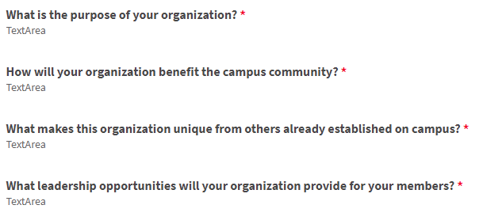
Step 10. For FSL groups, upload constitution and EIN documentation. For other groups, answer org questions.
Other groups
Fraternities and Sororities

Slide 12
Step 11. For FSL groups, complete questions and then submit. For other groups, review information and submit
Fraternities and Sororities

