Slide 1
Student Organization Advisor Training
Jeremy Sippel
Assistant Director, SGA and Student Organizations

Slide 2
Victim Outreach Coordinator – Elisbet Martinez

Slide 3
Role of an advisor
Providing support and advice to organization members and leaders
Reminding the students about organizational goals
Providing historical context
Ensuring the group acts in the institution’s best interest
Encouraging critical thinking and allowing students to make decisions
Reporting misconduct
Ensuring the organization is following policies
Mentoring and facilitating student growth and development

Slide 4
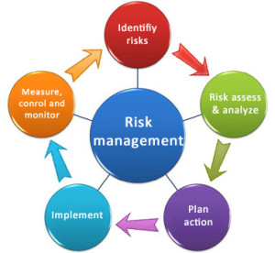
What is Risk Management?
Risk management is the process of analyzing risks posed by activities, and determining and implementing methods to manage the risk.
Identify risky behavior and activities (hazards)
Assess the probability/severity of adverse outcomes
Plan actions to take.
Implement controls to eliminate or reduce the risk
Reassess the activity after the risks have been managed

Slide 5
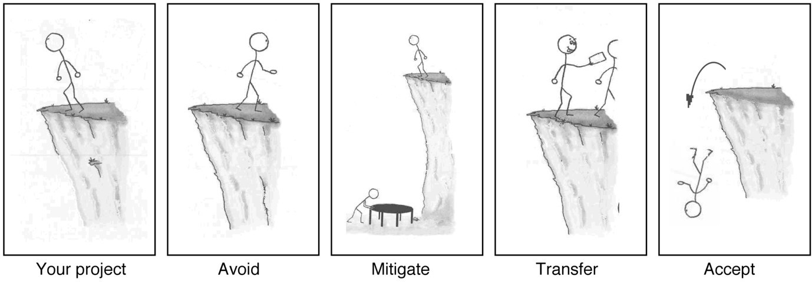
Methods to Manage Risk
AVOID: decide that the event or portion of the event is not worth the risk.
TRANSFER: use CERTIFICATES OF INSURANCE, proper contracting, and waivers.
MITIGATE: use proper safety equipment, educate participants on proper safety protocol, using common sense in unsafe conditions, hire security. Consider a risk management plan/assessment.
ACCEPT/RETAIN: The value of the activity is worth the risk.

Slide 6
Why is Risk Management Important?
Student organizations are independent of the university.
Aids in a decision making process that can avoid negligence (duty of care) and subsequent liability (legal responsibility).
A safer and more efficient outcome for all.

Slide 7
Advisor’s Personal Liability
As long as the advisor is acting within scope of their job, they are covered by the university.
It is always better to error on the side of caution.
Can be held liable if withholding information triggering negligence or falsifying information.
THINK! If a member is violating laws or University regulations in your presence, and you fail to discourage such activity, you may be seen as condoning it in failing to act. Liability can fall to individual members, the student organization, advisors and even the University.

Slide 8
Advisor Risk Management
Risk assessments must be signed off by advisors
  Please make sure to review an event and know the details.
If there is risk involved, help students work to mitigate the risk
  Financial risk example, if an organization does not have enough money to host an event, please encourage the organization to possibly scale back the program or apply for funding. Please do not let organization bank accounts go negative.
  Physical risk example, if there is an activity that could cause injury, help students develop plan to ensure attendee/participant safety

Slide 9
What Can You Do?
Create a simple Risk Management Policy addressing high-risk exposures such as:
Transportation
Contracts Alcohol & Illegal Drug
Hazing
Sexual assault, Harassment, Misconduct
Fire Safety & Use of Firearms
Member behavior.
2. Educate members
3. Confront inappropriate behavior

Slide 10
What Can You Do? Plan...
Transportation: vehicle type, when it is safe to drive, charter buses/amtrak
Contracts: Do NOT represent that you are the university. Get it in writing. Include insurance requirements for vendors if needed. Stipulate who can sign these agreements. Keep records. Address the “what ifs…”
Fire Safety: Functioning smoke alarms. No smoking inside campus facilities. Clear exits. Fire extinguishers. Ensure all facilities used meet fire codes.
Hazing & Alcohol: Clear policy, education, zero tolerance, reporting.
Sexual Assault, Harassment, Misconduct: Clear policy, education, reporting.

Slide 11
Event Planning
If you do plan to do an in-person event...
  Follow CDC and University Guidelines
    Outside no more than 10 people in a group, but you can have multiple groups of 10 spread out.
  Strategize safety – Have a plan
    Hand sanitizer
    Physical distancing – making sure you don’t go over capacity and group limits/crowd control
    Requiring masks to be worn
  Mindful of space on-campus
    Rooms have been decreased in capacity to accommodate physical distancing
    For example, RSC Board rooms previously allowed 10 people, now only have capacity of 4 people

Slide 12
Funding
Due to COVID, SOAC funding will be altered slightly
  Travel – Eligible for Registration (even if virtual)
    University not encouraging travel unless it is university mission critical
  Events- Case by case basis
    If an event is only for your organization (i.e. virtual event only open to your organization students)
      This is a 1X funding request ($200)
    If an event is open to all students, on-campus, will still be treated as on-campus event ($500)
      You will need to follow university guidelines and CDC guidelines
    If an event is virtual but open to all students with a provided link, will be treated similar to on-campus event ($500)
  Subscriptions for video conferencing
    Preferably do an annual subscription – use 1X funding
  If using 1X funding for a video conference subscription for only your organization
    Allowed 1 additional 1X funding request

Slide 13
Important Dates and Information
Organization registration
  Due October 2nd
  ManeSync registration
  Mandatory Training
    Sent to students via e-mail
    Presentation and quiz
  TAO Sexual Violence Prevention Training – 5 modules
Please notify me if there are any problems with presentation/quiz or TAO

Slide 14
New For This Year
Check out the resources page
  http://www.tamuc.edu/CampusLife/studentCenter/studentorganizations/resources.aspx
Encourage students to attend trainings
  They will be offered virtually and hopefully in-person (smaller groups)
ManeSync Virtual Fairs
  There will be virtual fairs scheduled throughout the semester
  Organizations will receive an invite
  Can post video conference link (i.e. Zoom/Microsoft Teams/etc.)

Slide 15
“New” For This Year
Want to know what your organization is doing
  Organization highlights
  Organization pictures
    Events
    Meetings
Restarting the newsletter...encourage organizations to submit highlights, events, and personal stories (i.e. what have they learned in their organization)
  If we don’t have material, the newsletter will cease

