Slide 1
SPS Meeting
October 17, 2017

Slide 2
Singing with the Stars – Karaoke Night
Tuesday November 14th, 6:30 pm
Concessions
Fundraiser to help raise money for SPS
Come sing WITH your professors
Will need volunteers later

Slide 3
Officer Elections
President – planning of meetings/game nights, sends out reminders and helps the department
Vice President – Assists with planning,
Treasurer – Handles $$$, sells T-shirts
Outreach Coordinator – Talks to others on outreach opportunities and fundraising
Historian – Takes pictures at events, loads them to google drive, updates hall board when needed

Slide 4

T-shirts
$15

Slide 5
REUs
Research Experience for Undergraduates

Slide 6
What is an REU
Summer Research Internship
Normally funded through the NSF
YOU GET $5000!

Slide 7
Common Misconceptions
“I don’t know enough physics/programming”
“I have never done research before”
“I will have to do research all summer, that wont be fun at all”
“What if I don’t even like the research?”
If you do an REU that isn’t in your field
  “Everyone will know so much more than me”

Slide 8
Why Should I do an REU?
REUs look great for Grad schools
Get experience doing research and feel more confident about research
Make some money
Experience a new place
Even if you go into industry, it looks like job experience
Make great friends
Scope out grad school prospects
YOU GET A RESEARCH PAPER OUT OF IT! (and sometimes they pay for national conferences)

Slide 9
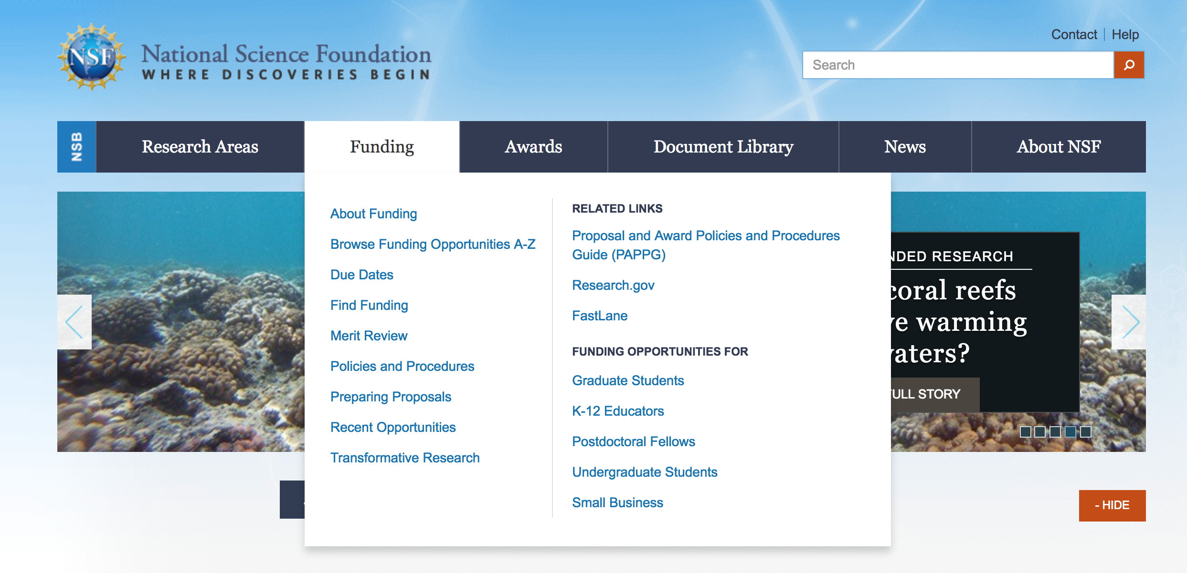

Slide 10
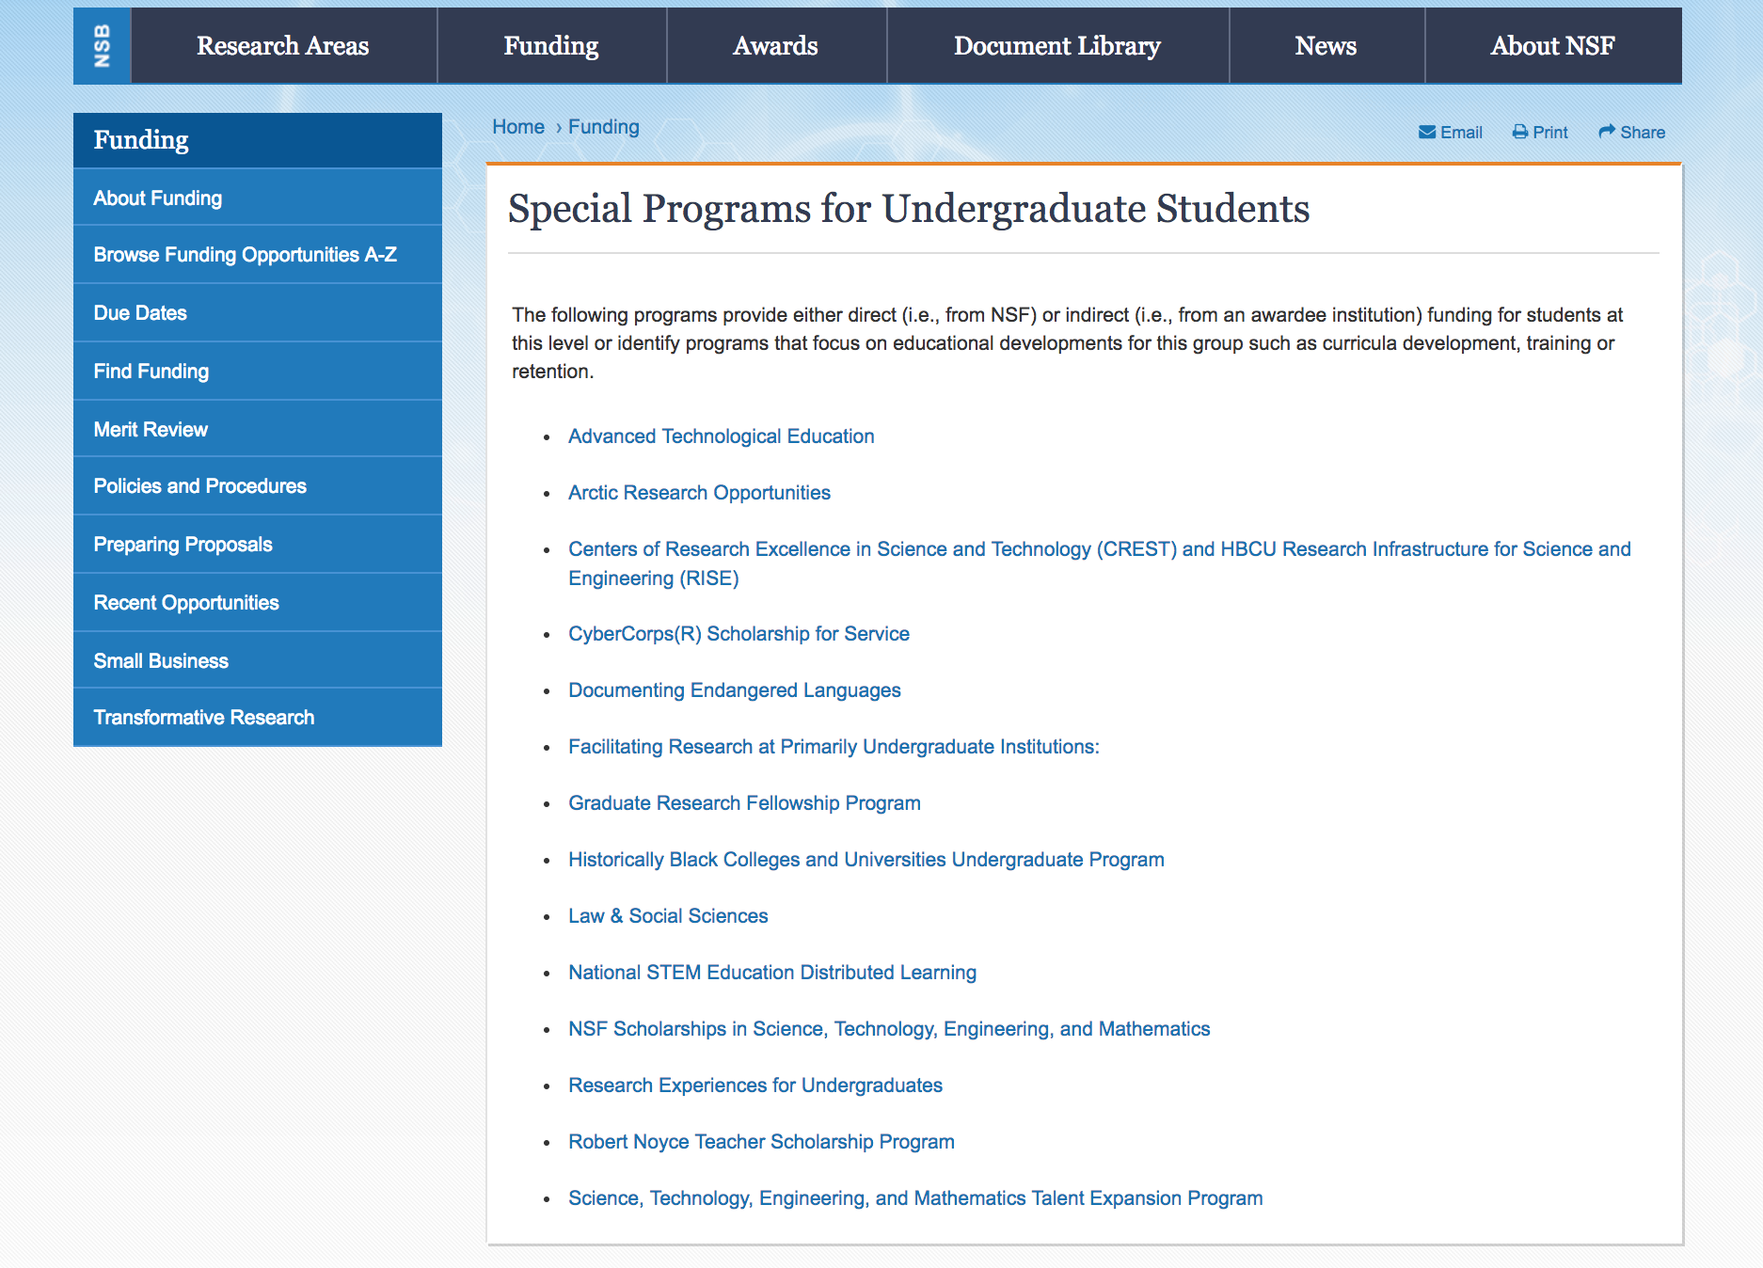

Slide 11
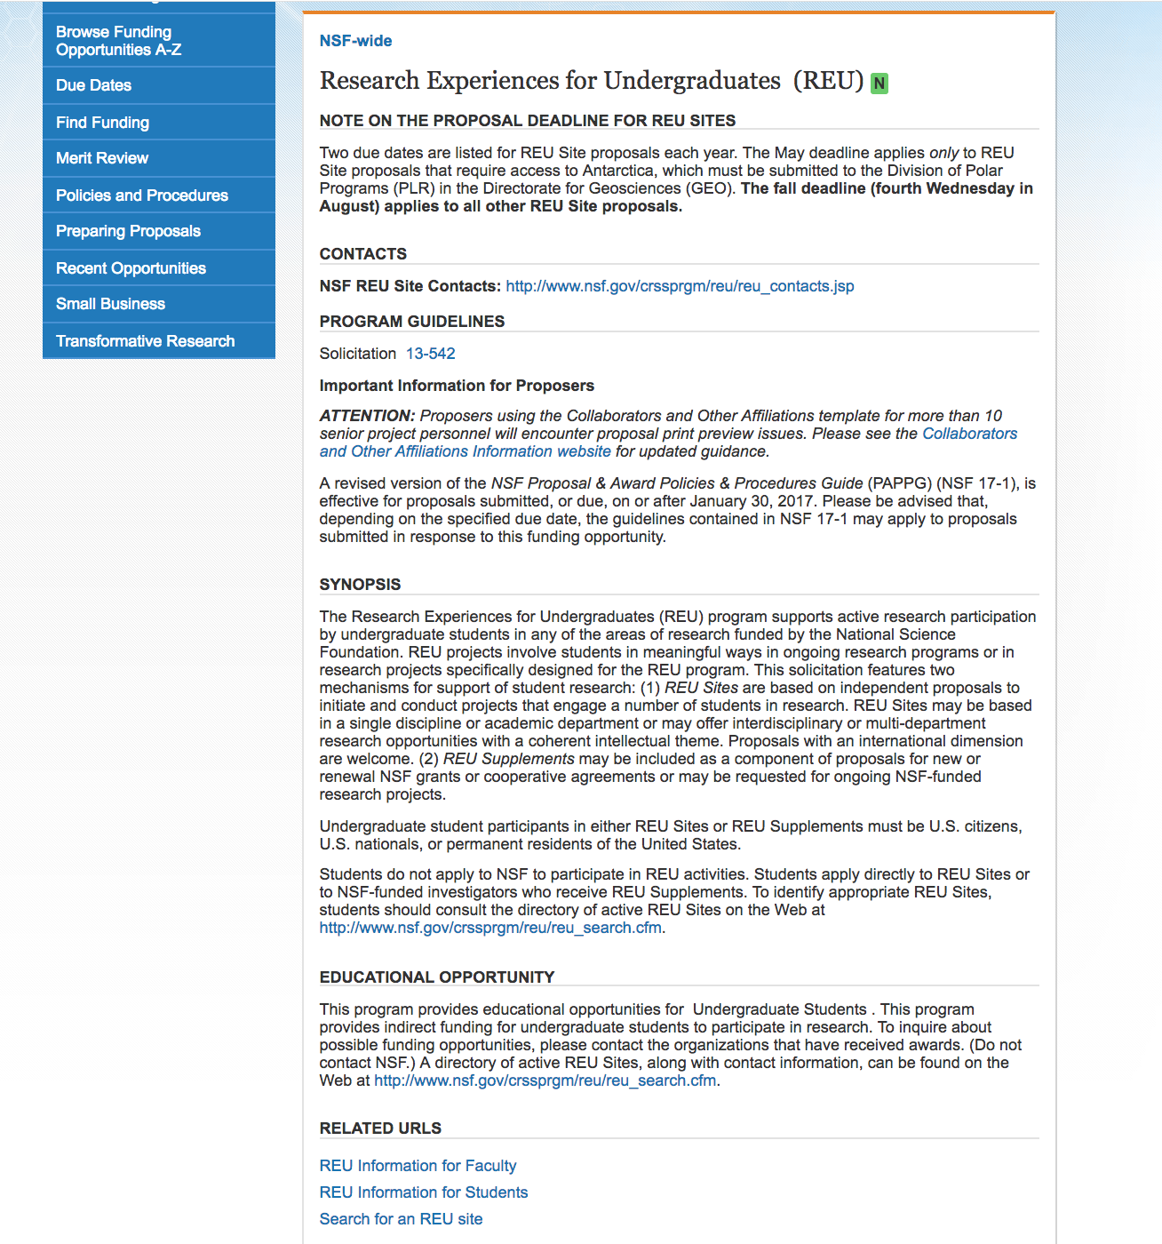

Slide 12
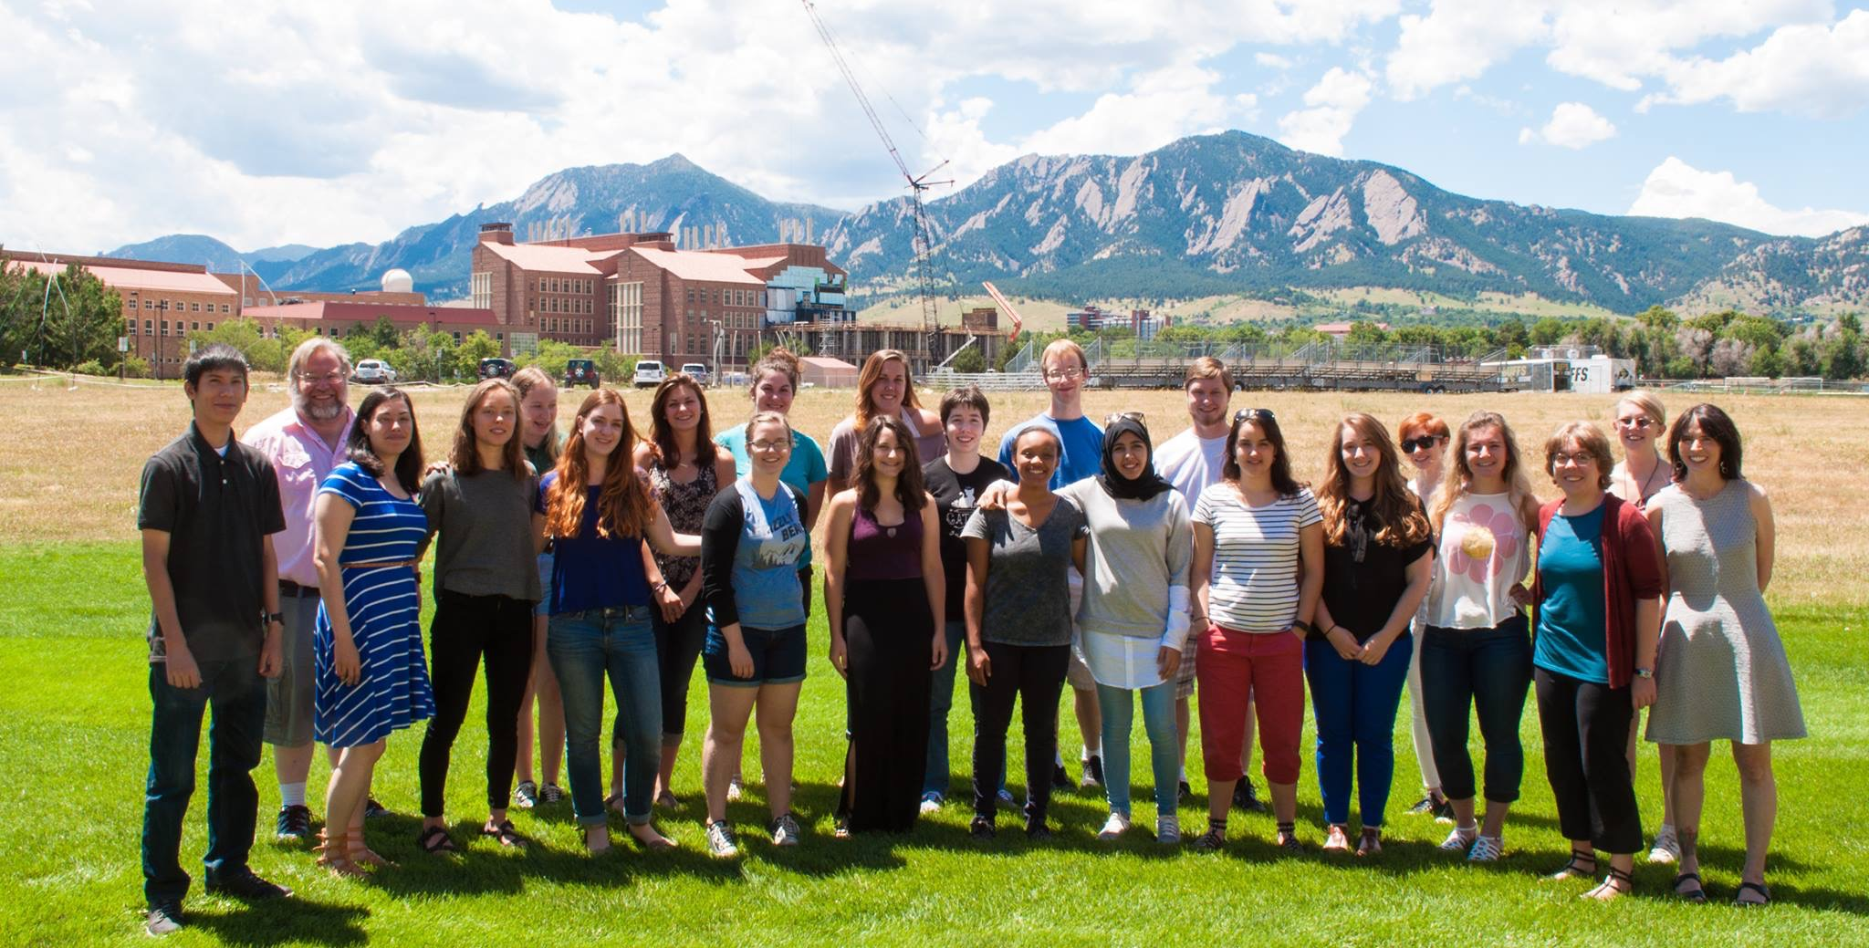
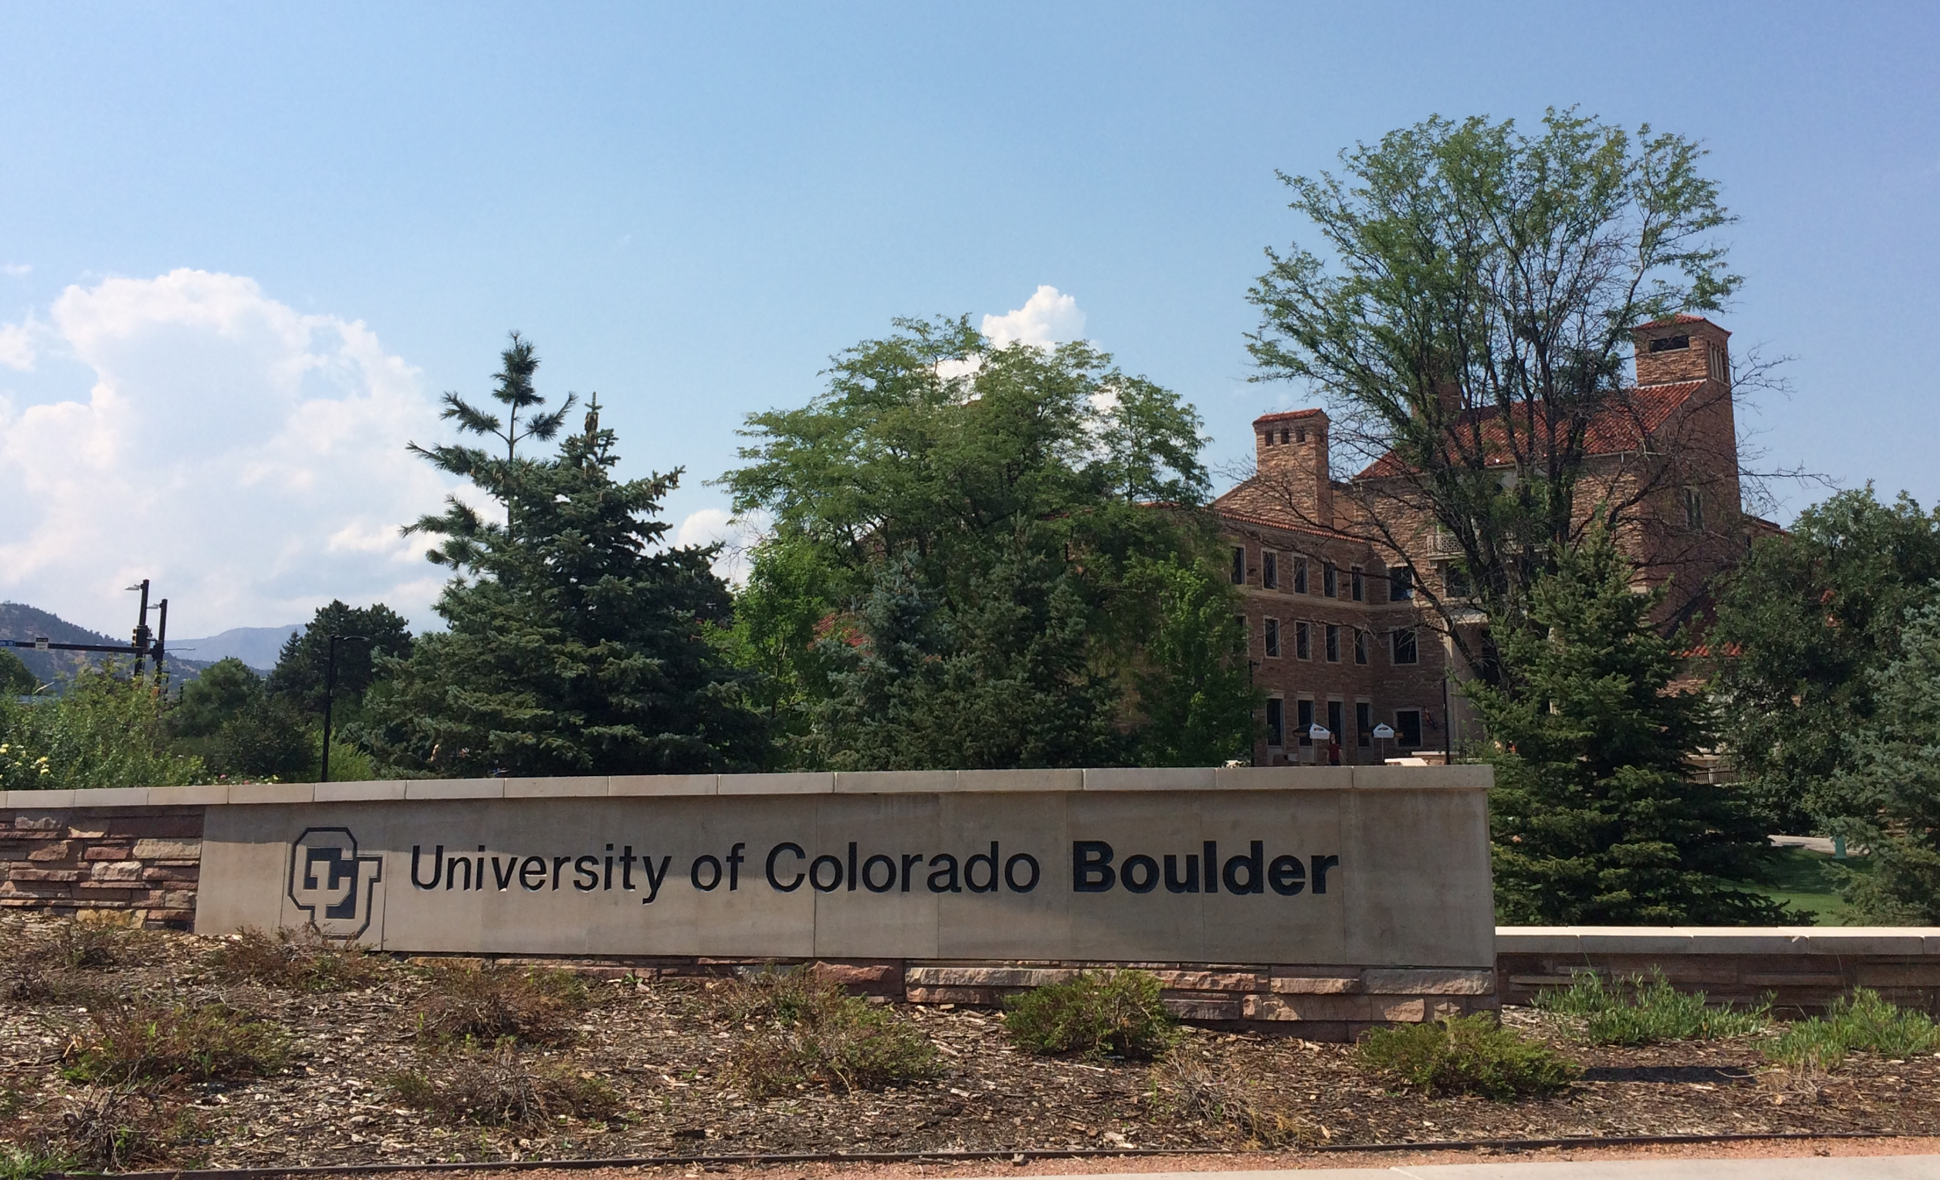
LeЯn’s REU Experience
How many REUs did you apply for?
13
How many did you get accepted in?
3, wait-listed on 2
When did you apply?
February of Junior Year
How much did you know before going in?
minimal coding experience

Slide 13

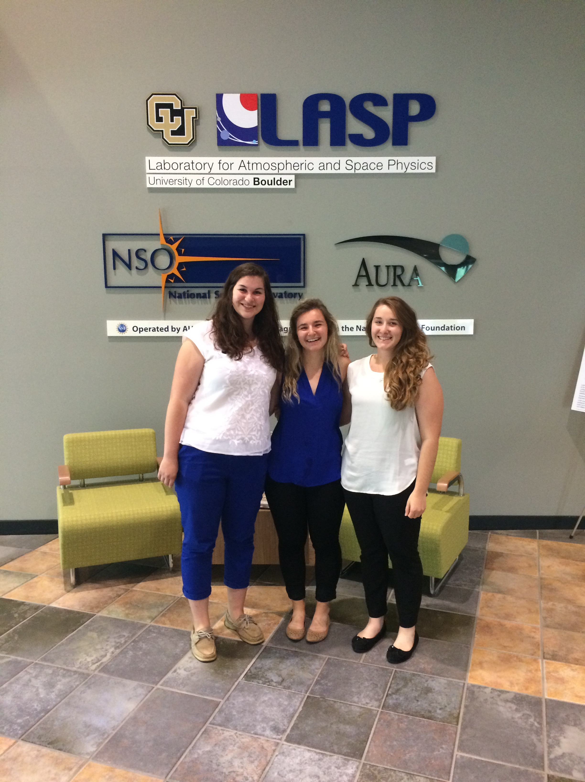
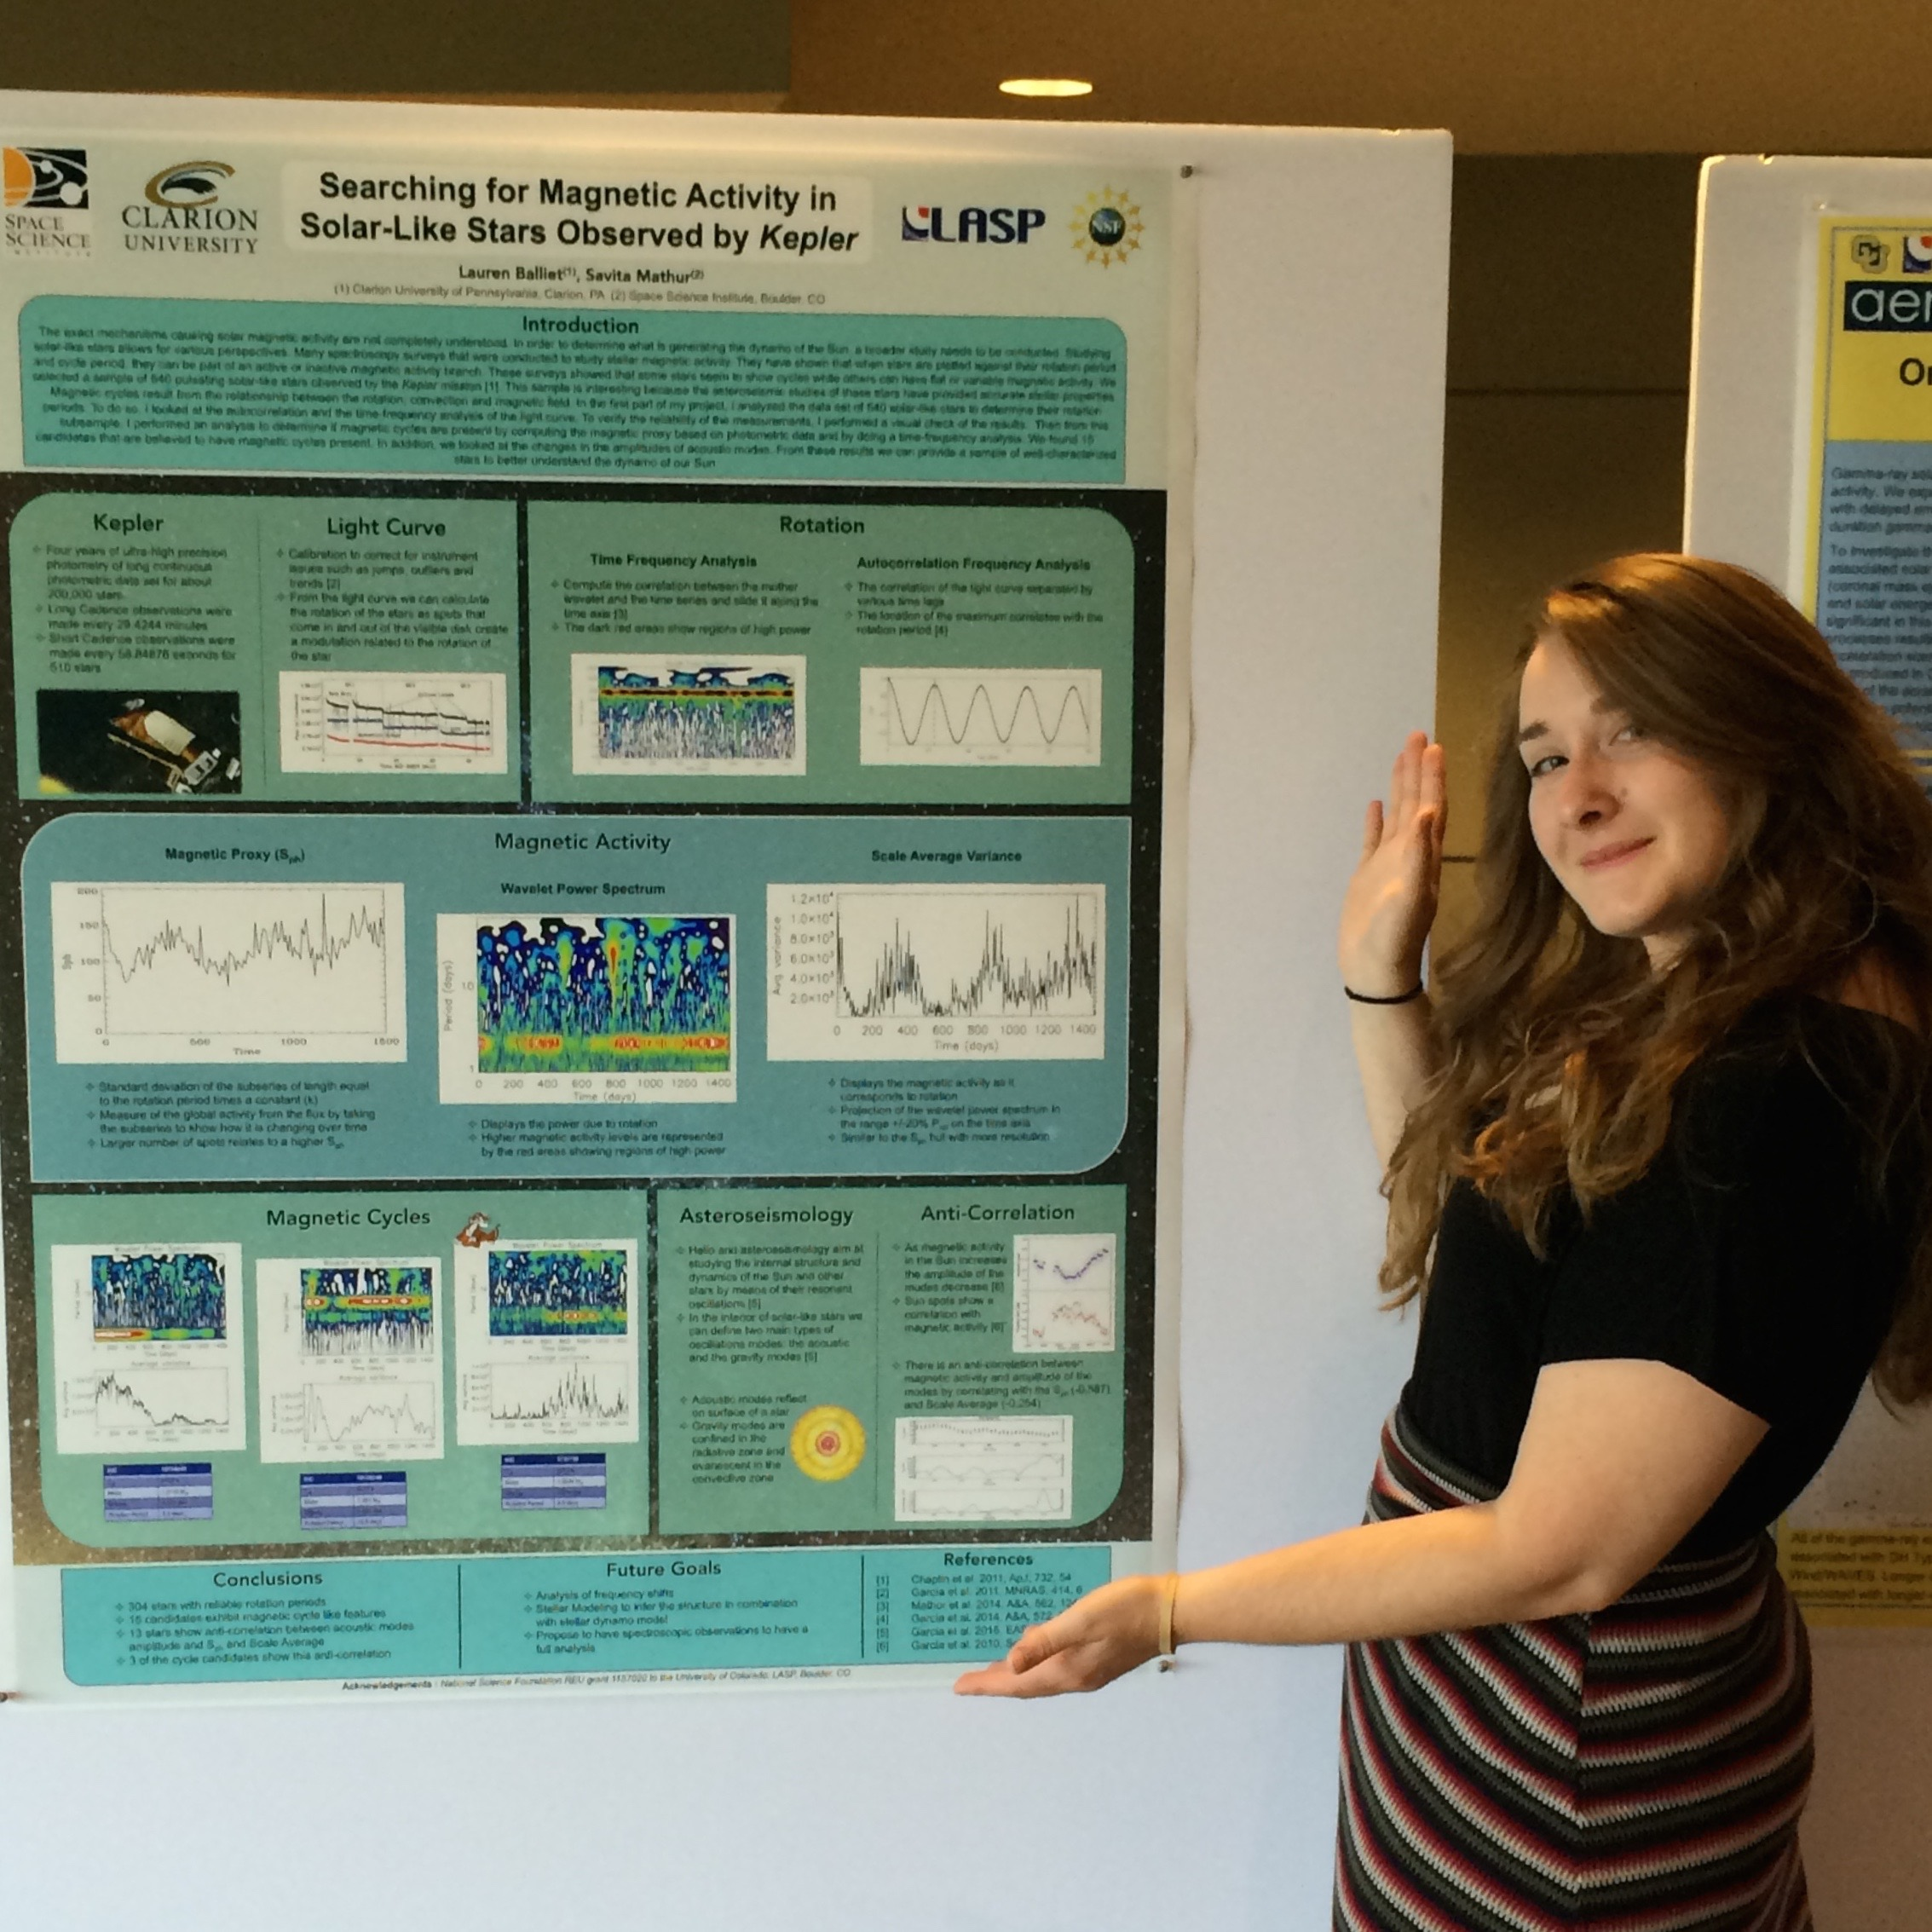
Presenting

Slide 14
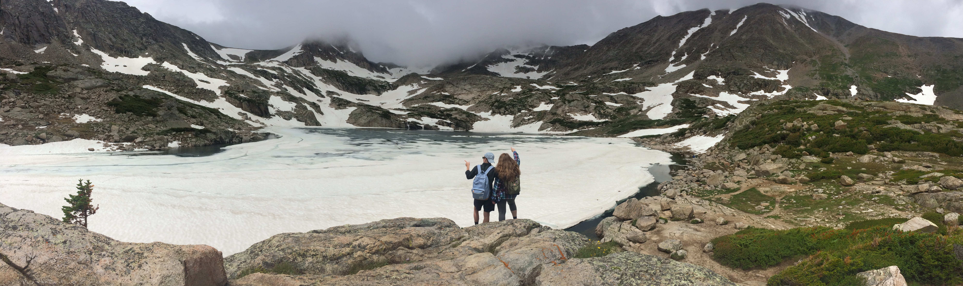
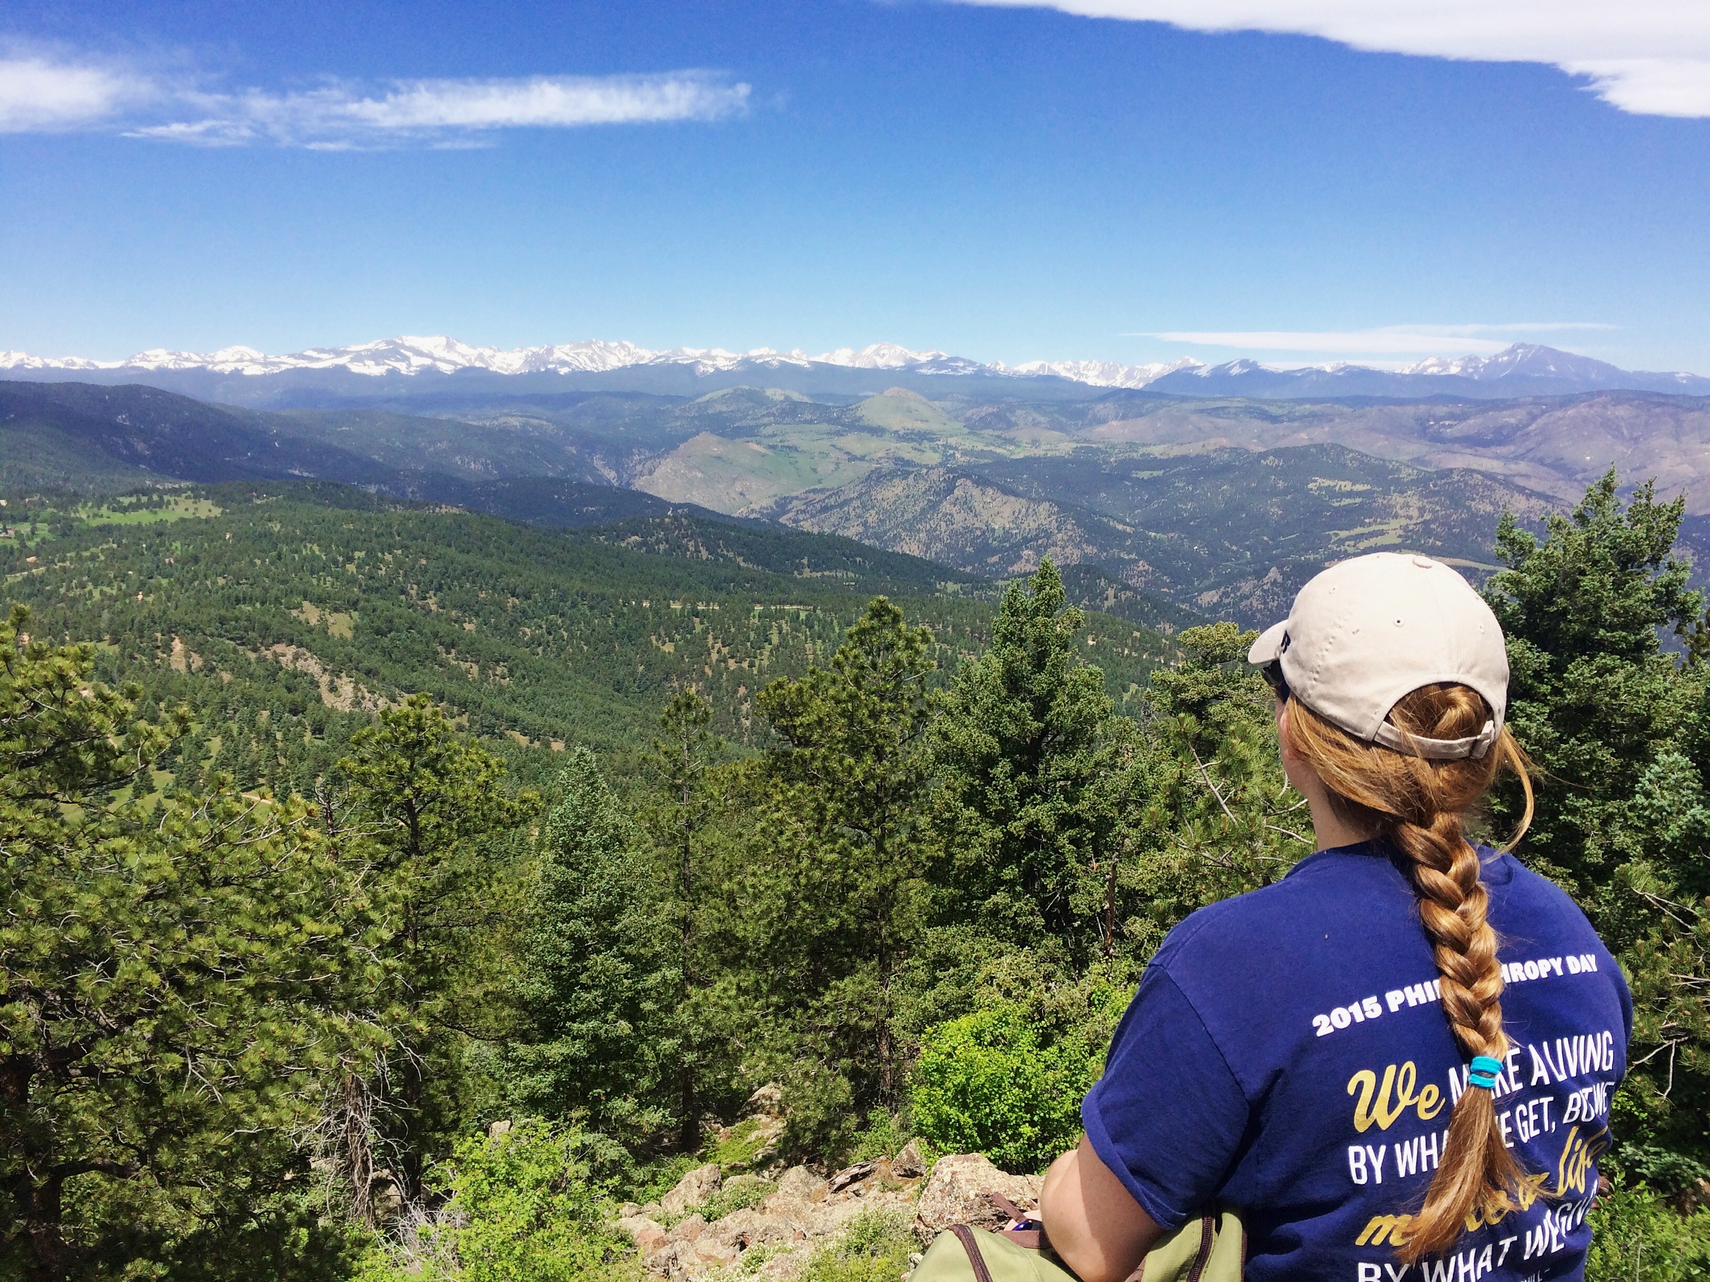
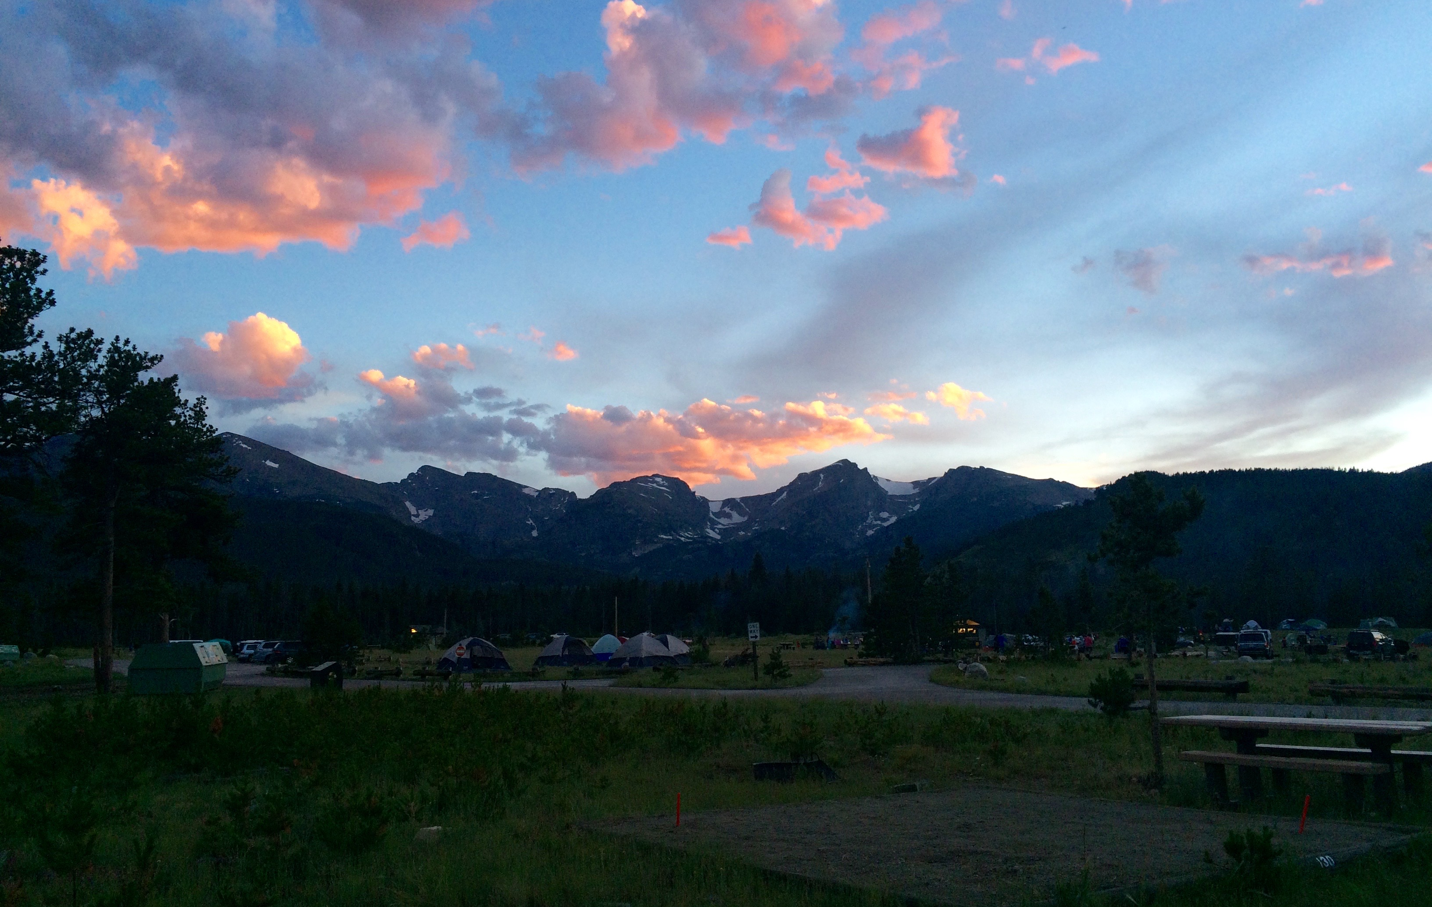
Fun Times!

Slide 15
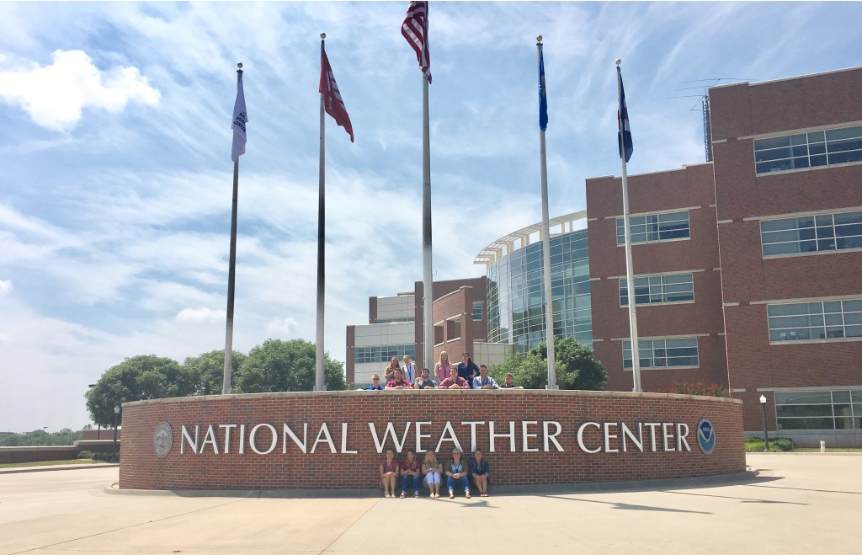
My Experience
NWC REU
How many REUs did you apply for?
7
How many did you get accepted in?
3, wait listed on 1
When did you apply?
Winter Break before my spring semester of Junior year
How much did you know before going in?
zer0

Slide 16
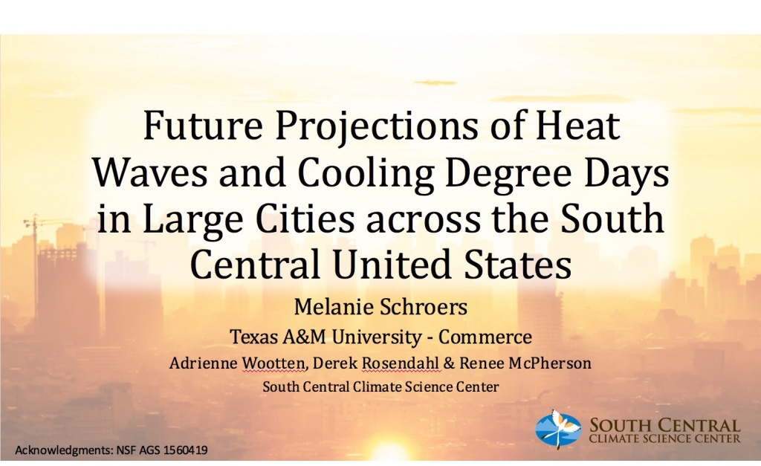
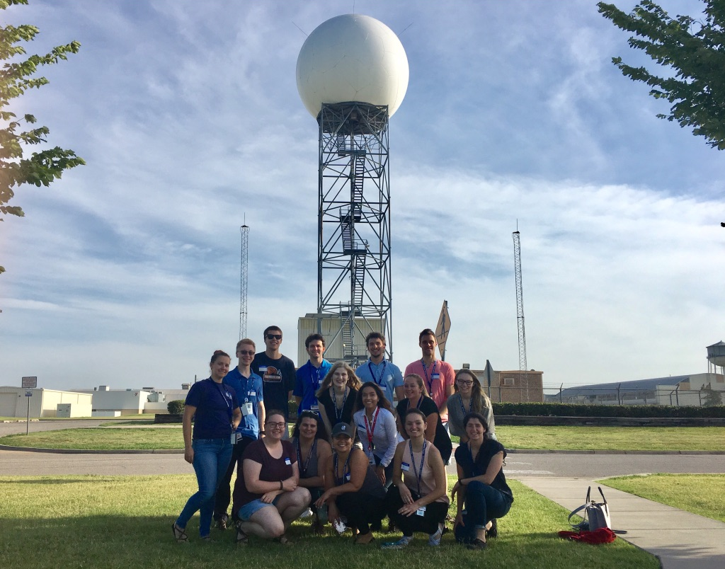

Slide 17
