Slide 1

COVID-19 is coming. Don’t be afraid, but be smart.
WASH YOUR HANDS!!!
  Often. With Soap.
  For 20 seconds (hum a verse of “Old MacDonald Had A Farm”)
  Dry your hands with paper towels, and use the towel to open the bathroom door.
Don’t touch your face with your hands.
Cover coughs and sneezes with a tissue and then throw it away.
  Elbows aren’t a great choice. Hands are a bad choice. Uncovered sneezes/coughs are pure evil.
Stay home if you are sick.
Avoid parties and unnecessary public events even if you’re healthy.
Face masks do not prevent getting the virus. Hand sanitizer doesn’t work nearly as well as soap but is better than nothing. Antibacterial soaps are no better than regular soap.

Slide 2
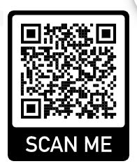
A&M-Commerce Student Health Services
Enrolled students may see the medical providers for free.
Labs, X-rays, and other additional services have charges.
See details and make an appointment at their website (use QR code)

