Slide 1
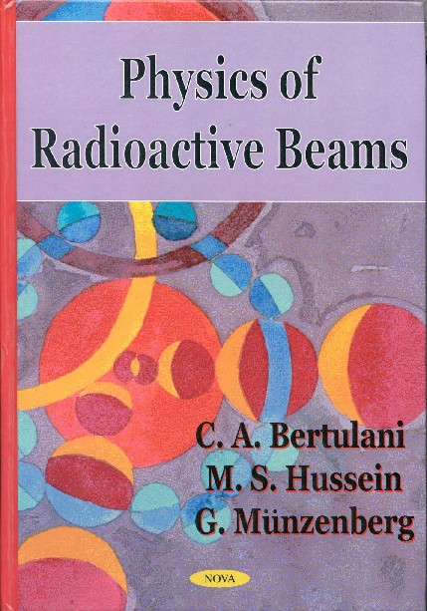
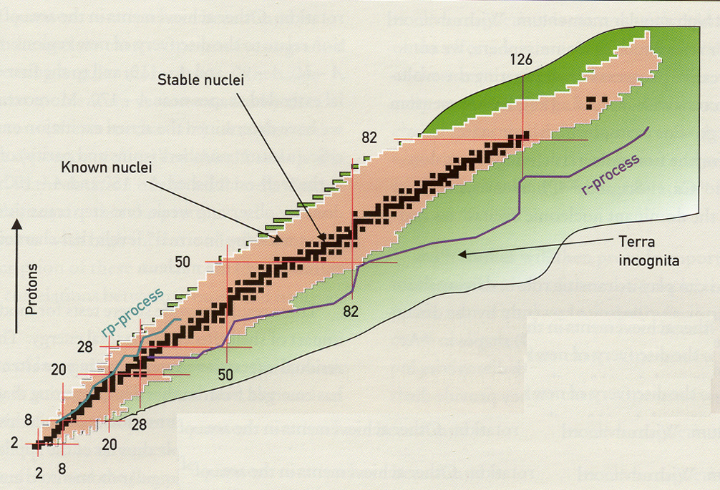
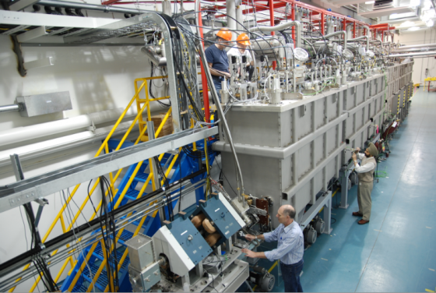
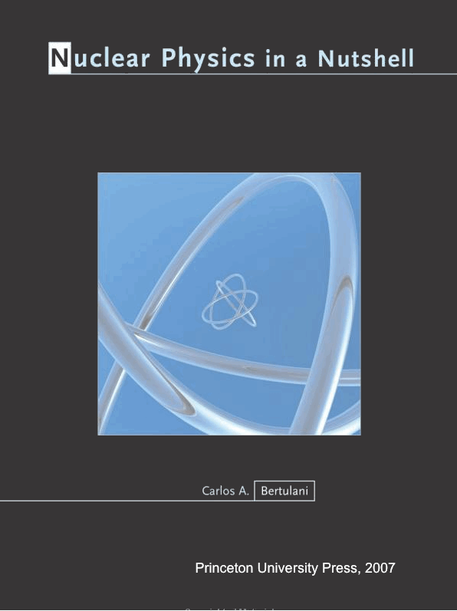
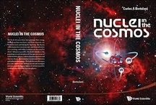
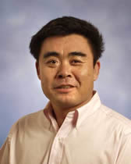
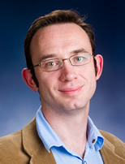
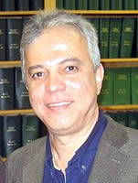
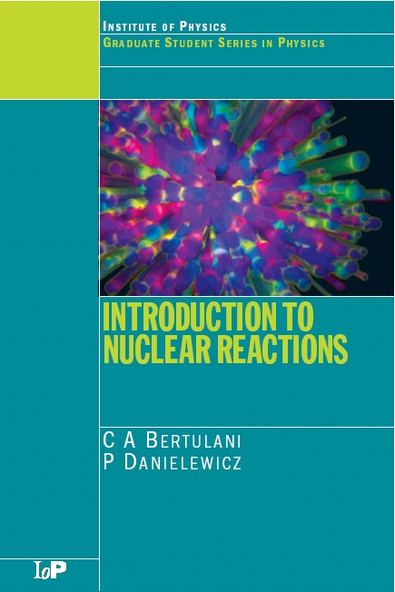
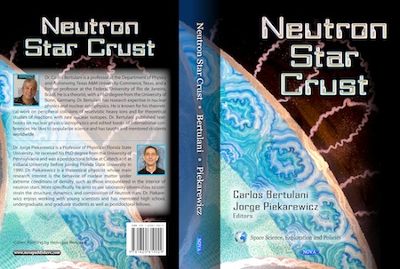
Reactions with Rare Nuclear Isotopes
Masses
Structure
Role in cosmos, fission
Societal applications
In US DOE will invest 1 Bi US$ on a Facility for Rare Isotope Beams. We are part of this investment.
Together:
- ~ 500 publications
7 books -- 4 textbooks
Organize numerous Int. conferences every year
Current funded by NSF, DOE, NASA, etc.
Former postdocs now professors in other universities
Former students in top research universities or well employed

Slide 2
Alumni (worked with C. Bertulani)
Arturo Samana (postdoc in 2009) → Associate Professor in Ilheus, Brazil
Wenhui Long → Professor in Lanzhou, China
Hongliang Liu → Assistant Professor in Xi’An University, China
Mesut Karakoc → Assistant Professor in Akdeniz University, Turkey
3 MS students + 2 undergrads now enrolled in major PhD programs in US
2 MS students have jobs in industry (defense), and teaching
Student involvement example (worked with C. Bertulani)
Big bang nucleosynthesis with a non-Maxwellian distribution
C.A. Bertulani, J. Fuqua and M.S. Hussein, Astrophys. Journal 167, 67 (2013).
Microscopic in-medium nucleon-nucleon cross sections
B. Chen, F. Sammarruca and C.A. Bertulani, Phs. Rev. C 87, 054616 (2013).
Dark/Visible Parallel Universes and Big Bang Nucleosynthesis, C.A. Bertulani, T. Frederico, J. Fuqua, M.S. Hussein, O. Oliveira, W. de Paula, AIP 2013.
Production of exotic atoms at the CERN Large Hadron Collider
C.A. Bertulani and M. Ellermann, Phys. Rev. C 81, 044910 (2010).
Radiative capture of protons and neutrons at astrophysical energiesJunting Huang, C.A. Bertulani and V. Guimaraes, ADNDT 96, 824 (2010).
Non-inertial effects in fusion reactions of astrophysical interest
C.A. Bertulani, Junting Huang and P. Krastev, Mod. Phys. Lett. A 24, 1109 (2009).
Our goal is not to build a “Stamp Collection”, but to provide you with education and knowhow transfer and to prepare you for a successful career.

